Slide 1
Animal and Plant Cells
Lesson 2

Slide 2
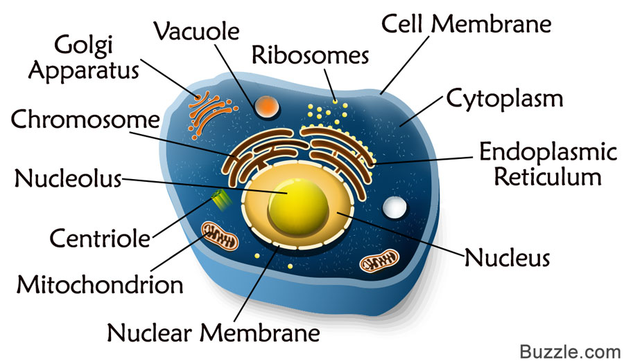
Structure of Animal Cells
Generally, each animal is made up of cell membrane and protoplasm.
Animal cells do not have cell walls and chloroplasts

Slide 3
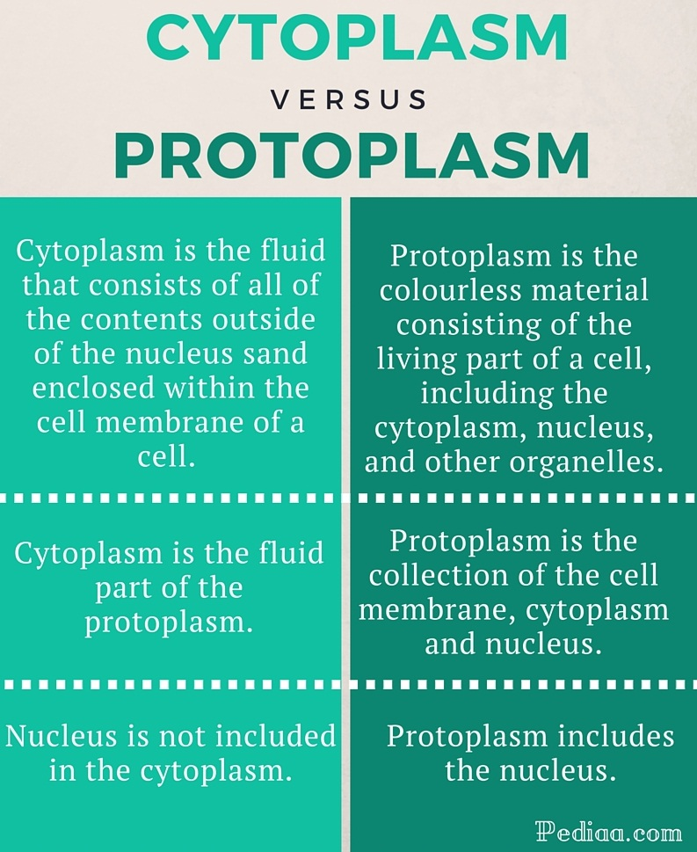
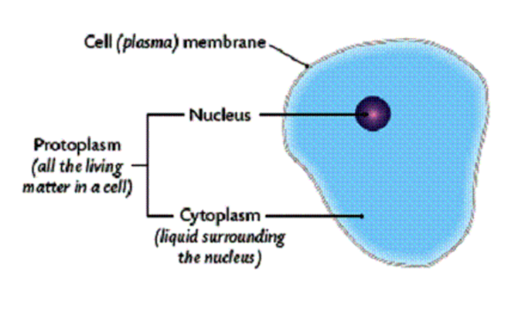

Slide 4
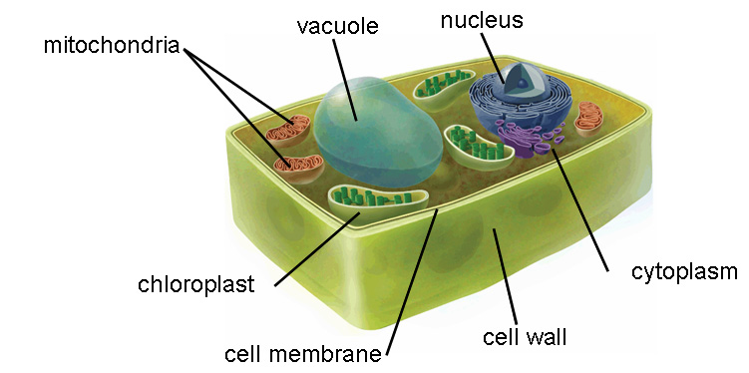
Structure of Plant Cells
The basic structure of plant cells is similar to that of animal cells in having a cell membrane, cytoplasm, and a nucleus.
All plant cells have a cell wall which gives them an almost fixed shape.
Plant cells often have one large vacuole and have chloroplast.

Slide 5
CELL ORGANELLES FUNCTIONS
ORGANELLE | PRESENT IN | FUNCTION
Cell Membrane | All cells | Encloses the cytoplasm Controls the movement of materials in and out of cells
Cell wall (a non-living layer of cellulose) | Plant cells only | Supports and gives shape to the cells
Cytoplasm (jelly-like substance) | All cells | This is where chemical reactions take place inside the cell Stores dissolved material
Nucleus | Almost all cells (mature red blood cells do not have nuclei) | Controls all cellular activities
Vacuole (cell sap) | Most plant cells and some animal cells | Holds useful substances and wastes Supports the plat when it is full of water

Slide 6
ANIMAL CELL VS. PLANT CELL
ASPECTS | ANIMAL CELL | PLANT CELL
SHAPE: | Irregular, generally smaller | Regular, generally bigger
SIZE: | Small | Big
CHLOROPLAST: | Absent | Present
STARCH GRAINS: | Absent | Found in cytoplasm
CELL WALL: | Absent | Present
VACUOLE: | Many small vacuole or none | Usually one and large
CYTOPLASM: | Cytoplasm fills the cell | Cytoplasm reduced to a thin lining

Slide 7
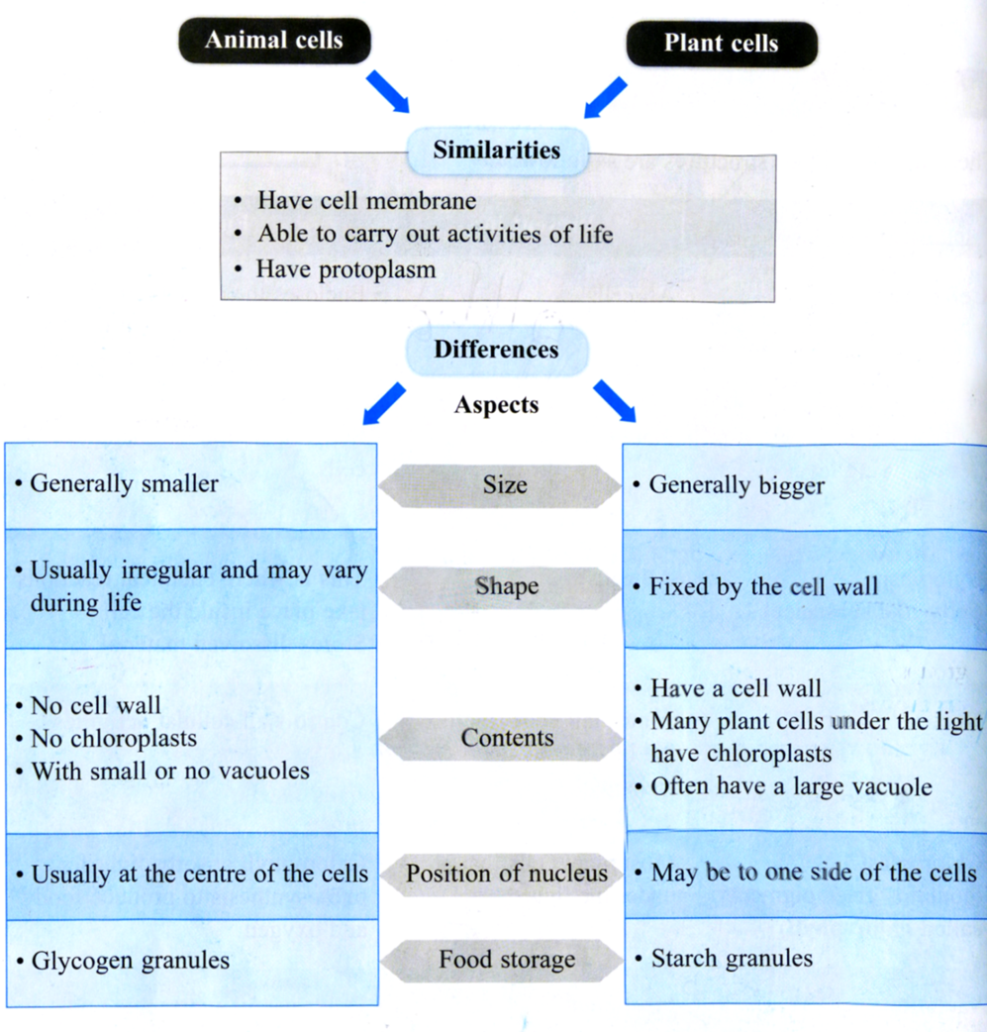

Slide 8
Test Yourself

