Slide 1
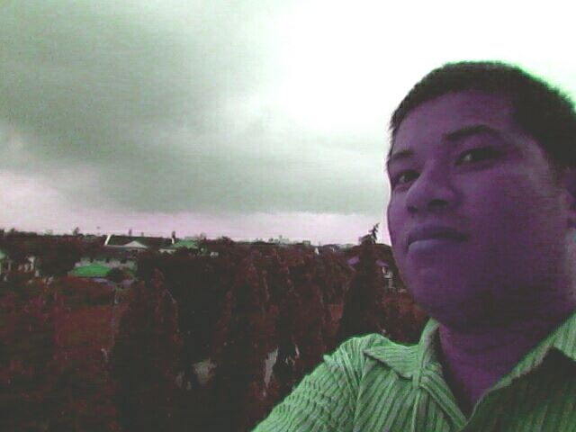
ATMOSPHERE

Slide 2
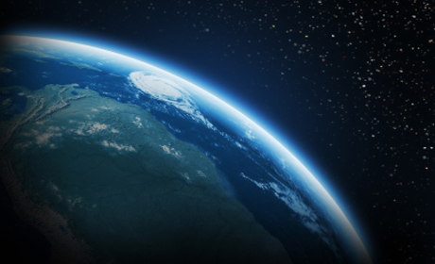
ATMOSPHERE
Our Earth is surrounded by a blanket of air.
It is made up of a mixture of gases, 78% Nitrogen, 21% oxygen, and the rests of the 1% are other gases and substances like dust particles.
Compared to the diameter of the Earth, atmosphere is very thin.

Slide 3
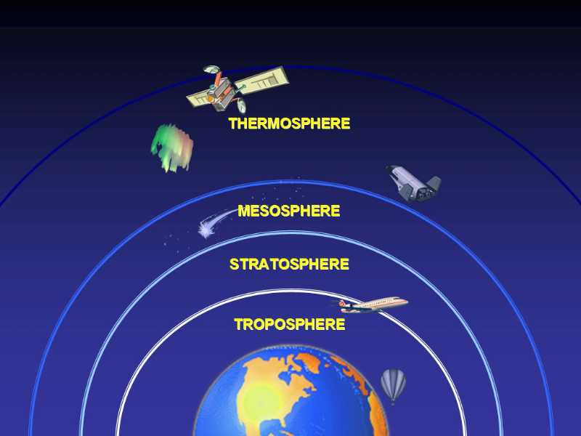
Different Layers
Our atmosphere can be divided into 5 layers.
They are held to the Earth by the force of gravity.
The temperature varies, depending the height from the earth. It rises and falls throughout the layers of the atmosphere.
Atmospheric pressure decreases as altitude increases. High altitudes contain less air molecules, resulting in lower air density, decreased temperatures and lower air pressure. High altitudes are typically found above sea level.

Slide 4
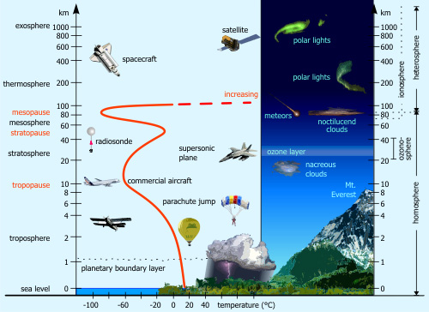

Slide 5
TROPOSPHERE
We live in the troposphere, the layer closest to the ground.
It is about 10km in height and contains 75% of the atmospheric gases.
Weather occurs here because this layer contain most of the water vapor.

Slide 6
STRATOSPHERE
The 2nd layer from the ground.
The stratosphere extends to the height of 50km.
There is no cloud here and the air is still. Therefore, most planes fly in this layer of air.
It contains a thin layer of ozone. This ozone layer absorbs the harmful ultraviolet rays from the Sun. These rays cause sunburn and skin cancer.

Slide 7
MESOSPHERE
The 3rd layer from the ground.
The air here is very cold and thin.
It extends to a height of 80km.
Most meteors (shooting stars) are slowed down and burnt out in this layer.

Slide 8
THERMOSPHERE
The fourth layer from the ground.
It is found between 80 km and 700 km above the earth.
Space shuttle fly in this area.
Aurora lights are found here.

Slide 9
EXOSPHERE
The furthest layer from the earth.
This is where the atmosphere merges in to the space.
Satellites are stationed here.

Slide 10
TEST YOURSELF:
What is atmosphere?
Name the layers of atmosphere, starting from the one closest to the Earth.
In which layer has the most of the atmosphere’s ozone?

Slide 11
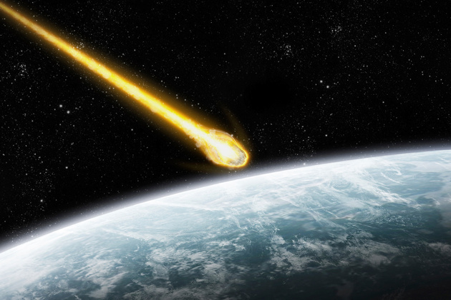
HOMEWORK 1:
Meteors burn up when they hit the Earth's atmosphere. Why doesn't the space shuttle?

Slide 12
ANSWER
When the meteor hits the atmosphere, the air in front of it compresses incredibly quickly. This causes the meteor to heat up so much that it glows. The air burns the meteor until there is nothing left.

Slide 13
HOMEWORK 2:
Why does the meteor burnt in mesosphere and not in thermosphere?

