Slide 1
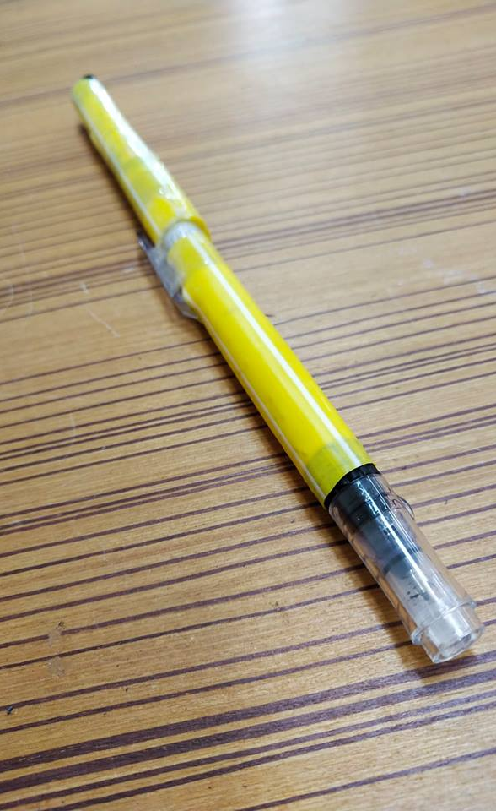
Eraser Pen
Based on the overall results in the graph above, it shows that the efficiency gets 9 votes for good out of 10, and the durability gets 10 votes for good out of 10, and practicality gets 8 votes for good out of 10, and the creativity gets 9 votes for excellent out of 10, and affordability gets 8 votes for good out of 10.
Conclusion
Based on the analysis of our data results, most of the votes of the eraser pen during the survey, got a higher scores between good and excellent. Therefore, the overall quality of our eraser pen is excellent and good.
Data Results
E.P. T.U.P.
English Program 1/15
Notes:
To change this brochure, replace our sample content with your own. Or, if you'd rather start from a clean slate, press the New Slide button on the Home tab to insert a new page. Now enter your text and pictures in the empty placeholders. If you need more placeholders for titles, subtitles or body text, copy any of the existing placeholders, then drag the new one into place.
And did you notice we made fold marks for you? They are really light, but if you don’t like them showing on your brochure, select and delete them before you print.

Slide 2
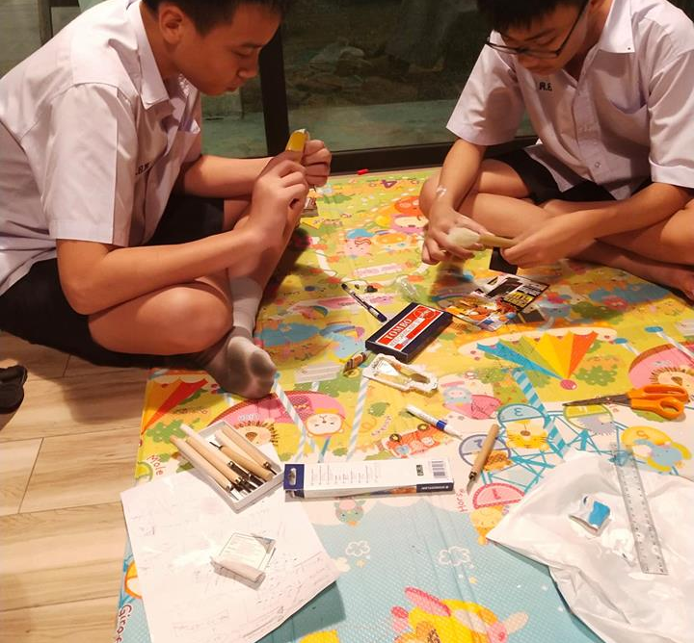
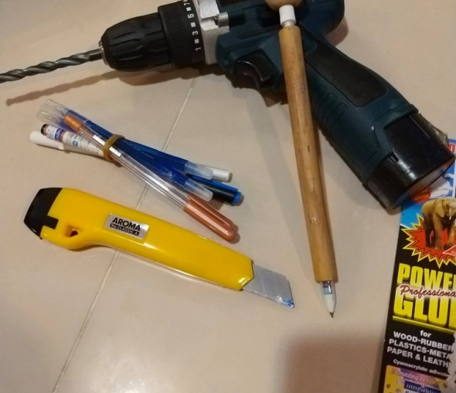
Purpose of the Study
ONE CLASS ONE PROJECT
Advisers:
1)Chopaga Srabua
2)Alon Mayormita
Group Members:
1)Jirapat no.2
Napat no.4
Peakthipol no.7
Pakaphol no.9
Hejun no.11
Akira n0. 12
To make the pen more useful in other words this pen will contain both ink and liquid paper and that’ll let people carry less things to school or to work.
Benefits of the Study
Abstract
Learn how pen works with liquid eraser
Reduce risks of losing liquid paper or pen
Carry only a thing to school
Make a pen more useful because there’s only one pen
The objective of the project is to join both to join them together in order to make them handy.
This project will answer that the eraser pen is better solution than bringing to school or to work if its successful enough.
Scope of the Study
Male and Female Students
M1-M3 Thai Students
1 week survey
Notes:
To change this brochure, replace our sample content with your own. Or, if you'd rather start from a clean slate, press the New Slide button on the Home tab to insert a new page. Now enter your text and pictures in the empty placeholders. If you need more placeholders for titles, subtitles or body text, copy any of the existing placeholders, then drag the new one into place.
And did you notice we made fold marks for you? They are really light, but if you don’t like them showing on your brochure, select and delete them before you print.

