Slide 1
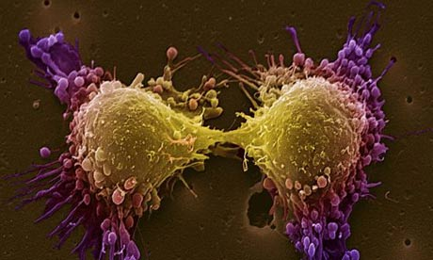
Introduction to Cell Division

Slide 2
Science Vocabs
Cell Cycle -
Interphase -
Cell Division -
Mitosis -
Meiosis -
Parent cell -
Daughter cell -
Prophase -
Metaphase -
Anaphase -
Telophase -
Cytokinesis -
Crossing Over -

Slide 3
Cell Division
All cells come from other living cells.
You (and other living things) grow because your cells get bigger and your number of cells gets larger.
A single cell divides into two cells.
Two cells divide into four, etc.
Cells must also divide because old cells die and need new cells to replace them!

Slide 4
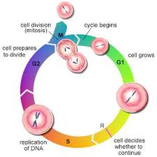
The Cell Cycle
Cell cycle – regular sequence of growth and division that eukaryotic cells undergo.
Prokaryotic cells undergo binary fission
Divided into three main stages:
Interphase – cell grows into its mature size, makes a copy of its DNA, and prepares for division.
Mitosis – one copy of the DNA is distributed into each of its daughter cells
Cytokinesis – the cytoplasm divides and organelles are distributed into the two new cells

Slide 5
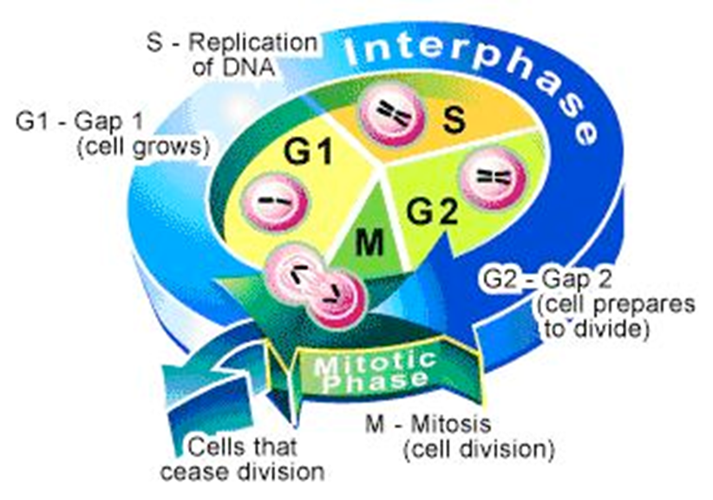
Interphase
Interphase is made up of 3 separate parts.
G1
S
G2
Interphase is the stage that the cell is in for most of its life!

Slide 6
Sister Chromatids & Chromosomes
Human somatic cells (any cell other than a gamete) have 23 pairs of chromosomes. – one from mom and one from dad. These are called homologous chromosomes.
Copy of chromosome from mom
or dad
Chromosome made in S phase of
Interphase

Slide 7
The cell’s chromatin condenses into chromosomes
The chromosomes look like an “X”
Each chromosome is made up of two identical sister chromatids attached by a centromere
This is “created” in S phase of interphase

Slide 8
Chromosome Structure

Slide 9
G1 – Growth Phase
Cell doubles in size
Cell produces all of the structures it needs to carry out its functions
Think of this phase as the cell just living its normal life.

Slide 10
S – DNA Copying
Cell makes a copy of its DNA (replication)
This happens because the new cell needs all of the directions for its function and survival.
Think of this phase as placing the DNA on a copy machine.

Slide 11
G2 – Preparation
Cell prepares to divide
Cell produces structures needed for cell division
Think of this phase as the cell double checking everything it needs to divide.

Slide 12
Learning Checkpoint
1. T/F: Interphase is usually divided into 3 phases: G1, S, G2.
2. The ________ is the regular sequence of growth and division that cells undergo.
3. ________ is the stage of the cell cycle where the cell grows to its mature size, copies it DNA, and prepare to divide.
4. DNA is replicated during: A. interphase
B. prophase
C. metaphase
D. cytokinesis

Slide 13
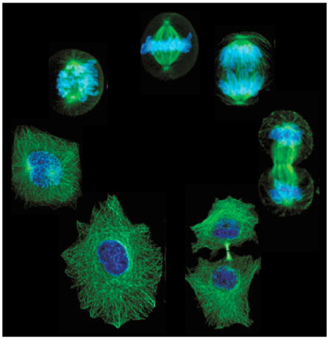
Mitosis and Cytokinesis

Slide 14
Mitosis
During mitosis, the cells’ copied genetic material separates and the cell prepares to split into two cells
This allows the cell’s genetic material to pass into the new cells
The resulting daughter cells are genetically identical!!

Slide 15
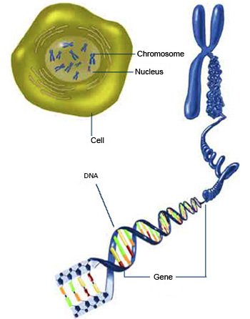
Where Do I Find DNA?
Chromosomes are in the
nucleus of every cell.
Chromosomes are made
up of DNA.
Genes are pieces of DNA
that contain the instructions
for building a protein.

Slide 16
The Four Stages of Mitosis
Remember PMAT!
Prophase
Metaphase
Anaphase
Telophase

Slide 17
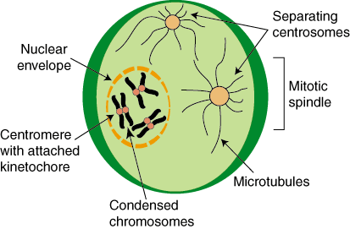
Prophase
Nucleus disappears
Spindle fibers form in the cytoplasm
Spindle fibers attach to sister chromatids

Slide 18
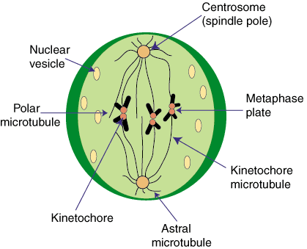
Metaphase
The sister chromatids are pulled to the center of the cell
They line up in the middle of the cell

Slide 19
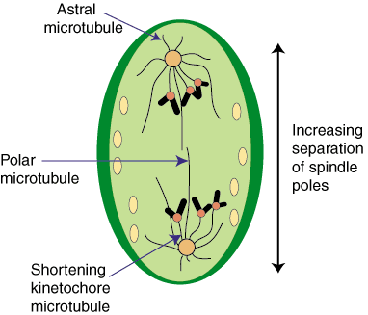
Anaphase
Spindle fibers begin to shorten
The sister chromatids are pulled to the opposite ends of the cell

Slide 20
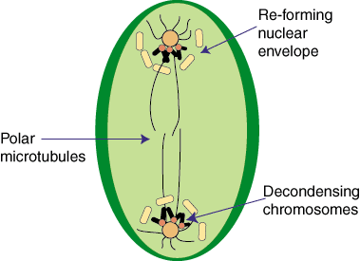
Telophase
The sister chromatids arrive at the opposite poles of the cell and begin to unravel
New nucleus begins to form

Slide 21
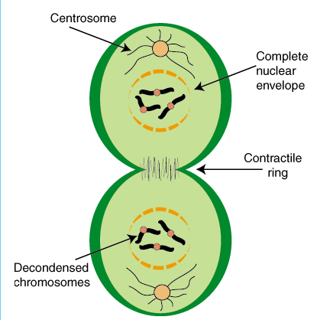
Cytokinesis
Cytokinesis is the division of the cytoplasm
Results in two separate daughter cells with identical nuclei

Slide 22
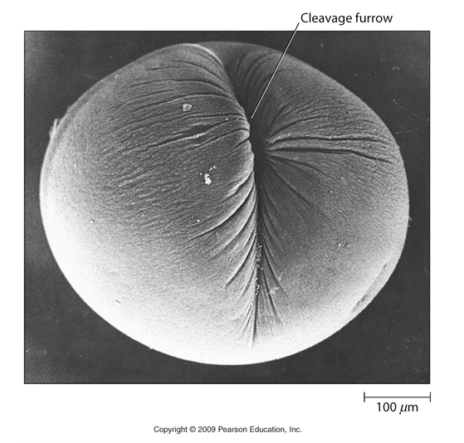
Cytokinesis
In animal cells, it is accomplished by using microfilaments to “pinch” the cytoplasm.
In plants, a cell plate forms between the two daughter nuclei.

Slide 23
Real-Life Cells Dividing!
Animated Mitosis

Slide 24
Mitosis Learning Checkpoint
Which phase do cells spend the most time?
What are the 3 stages of interphase?
What kinds of cells go through mitosis?
What are the 4 stages of mitosis?
What is the result of mitosis?
Using your own words, summarize the process of mitosis and cytokinesis cell division.

Slide 25
Meiosis

Slide 26
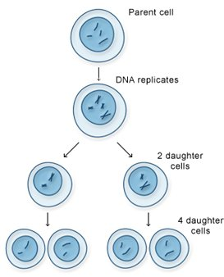
Meiosis - the process of cell division that produces haploid gametes (half the number of chromosomes: humans: 23)

Slide 27
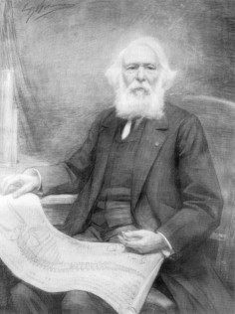
Discovery of Meiosis
In 1882, British cytologist Pierre-Joseph
van Beneden found different numbers of chromosomes in different cells
Specifically, he observed that gametes (sperm & egg) contain half the number of chromosomes compared to somatic cells (nonreproductive cells).

Slide 28
Fertilization
Van Beneden then proposed that an egg and a sperm fuse to produce a zygote .
The zygote contains two copies of each chromosome (one copy from the sperm and one copy from the egg). These are called homologous chromosomes.
Fertilization is the name for the fusion of gametes.

Slide 29
Reduction Division
Since the sperm and the egg contain only half the number of chromosomes, they cannot be formed from mitosis.
Meiosis - the process of cell division that produces gametes with half the number of chromosomes as somatic cells
Cell undergoes 2 rounds of cell division:
Meiosis 1
Meiosis 2
Humans have 46 chromosomes in their somatic cells.

Slide 30
The Sexual Life Cycle

Slide 31
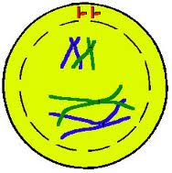
Unique Features of Meiosis
Feature #1 – Synapsis
Following chromosome replication, the homologous chromosomes pair all along their length. This process is called synapsis.

Slide 32
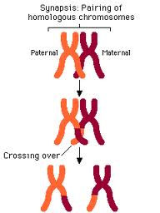
Unique Features of Meiosis
Feature #2 – Crossing Over
While the homologous chromosomes are joined, crossing over occurs. Crossing over is the exchange of genetic material from homologous chromosomes.
This causes genetic variations.

Slide 33
Synapsis and Crossing Over

Slide 34
Unique Features of Meiosis
Feature #3 – Reduction Division
The chromosomes are not copied in between the two divisions. At the end of meiosis, each cell contains one half the genetic material. (haploid or “n”)

Slide 35
Reduction Division

Slide 36
Prior to Meiosis I
Preceded by Interphase- chromosomes are replicated to form sister chromatids
Sister chromatids are genetically identical and joined at centromere
Single centrosome replicates, forming 2 centrosomes

Slide 37
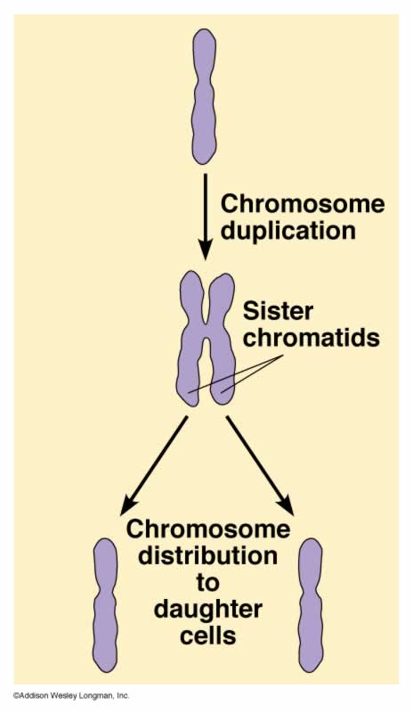
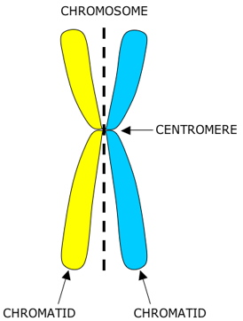

Slide 38
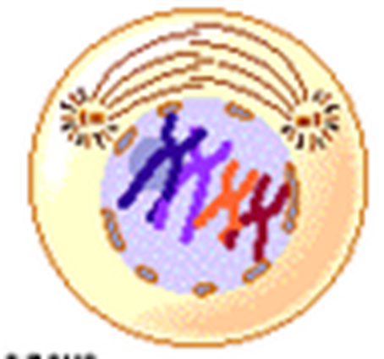
Prophase I
Individual chromosomes first become visible
homologous chromosomes become closely associated in synapsis
crossing over occurs
Crossing over is a complex series of events in which DNA segments are exchanged between nonsister or sister chromatids.

Slide 39
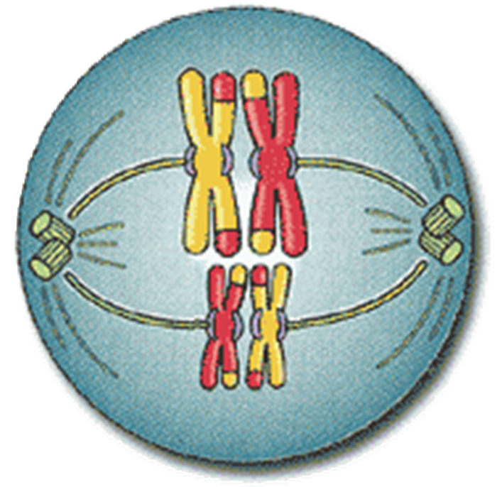
Metaphase I
The homologous chromosomes line up in the center of the cell and are still held together

Slide 40
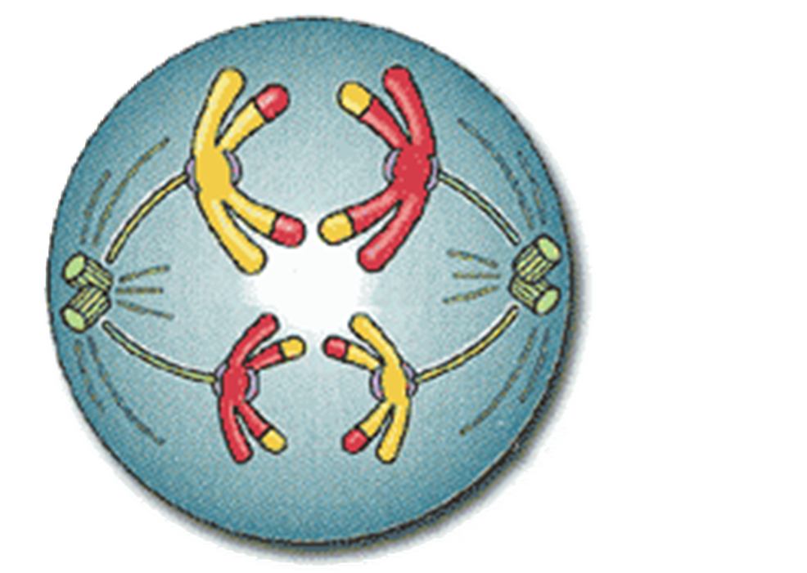
Anaphase I
Spindle fibers shorten
The homologous chromosomes are separated (the sister chromatids are still paired)
Independent assortment – random chromosomes move to each pole; some may be maternal and some may be paternal

Slide 41
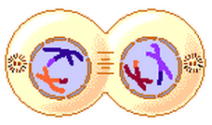
Telophase I
The nuclear membrane reforms around each daughter nucleus
Each new cell now contains two sister chromatids that are NOT identical due to crossing over

Slide 42
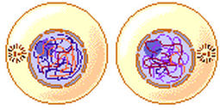
At the end of Meiosis I…
You have made 2 cells
Each cell contains a haploid number of chromosomes – 1 copy of each chromosome
(for humans, each haploid cell has 23 chromosomes)
No DNA replication occurs between Meiosis I and Meiosis II
Meiosis II resembles normal, mitotic division

Slide 43
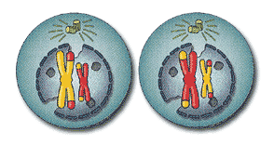
Prophase II
Nuclear membrane breaks down again

Slide 44
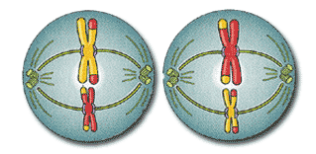
Metaphase II
The chromosomes line up in the middle of the cell.

Slide 45
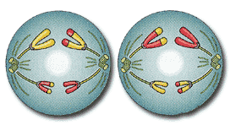
Anaphase II
The spindle fibers shorten and the sister chromatids move to opposite poles.

Slide 46
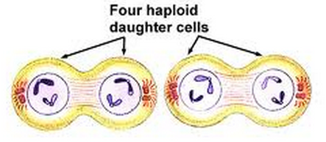
Telophase II
Nuclear envelope re-forms around the four sets of daughter chromosomes.

Slide 47
At the end of Meiosis II…
At the end of Meiosis II, there are 4 haploid cells. (only 1 copy of each chromosome)
(for humans, each haploid cell has 23 chromosomes)
No two of these haploid cells are alike due to crossing over.
This is why you and your siblings are genetically unique!

Slide 48
Meiosis Quick Check Questions:
What kinds of cells does mitosis produce?
How many chromosomes do human haploid cells have?
What kinds of cells does meiosis produce?
How many cells are produced when one cell goes through meiosis?
How many times are chromosomes replicated during meiosis?
How do cells in meiosis get to be different?
If an organism’s somatic cells have 36 chromosomes, how many chromosomes do their gametes have?

