Slide 1
Introduction to Cell and Microscope
Unit 3: Lesson 1

Slide 2
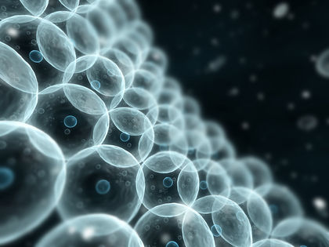
Cells
Living organisms are made up of one or more cells.
Cells are the most basic unit of organisms which can function on their own.
Cells carry out life processes such as respiration, division, excretion, and growth

Slide 3
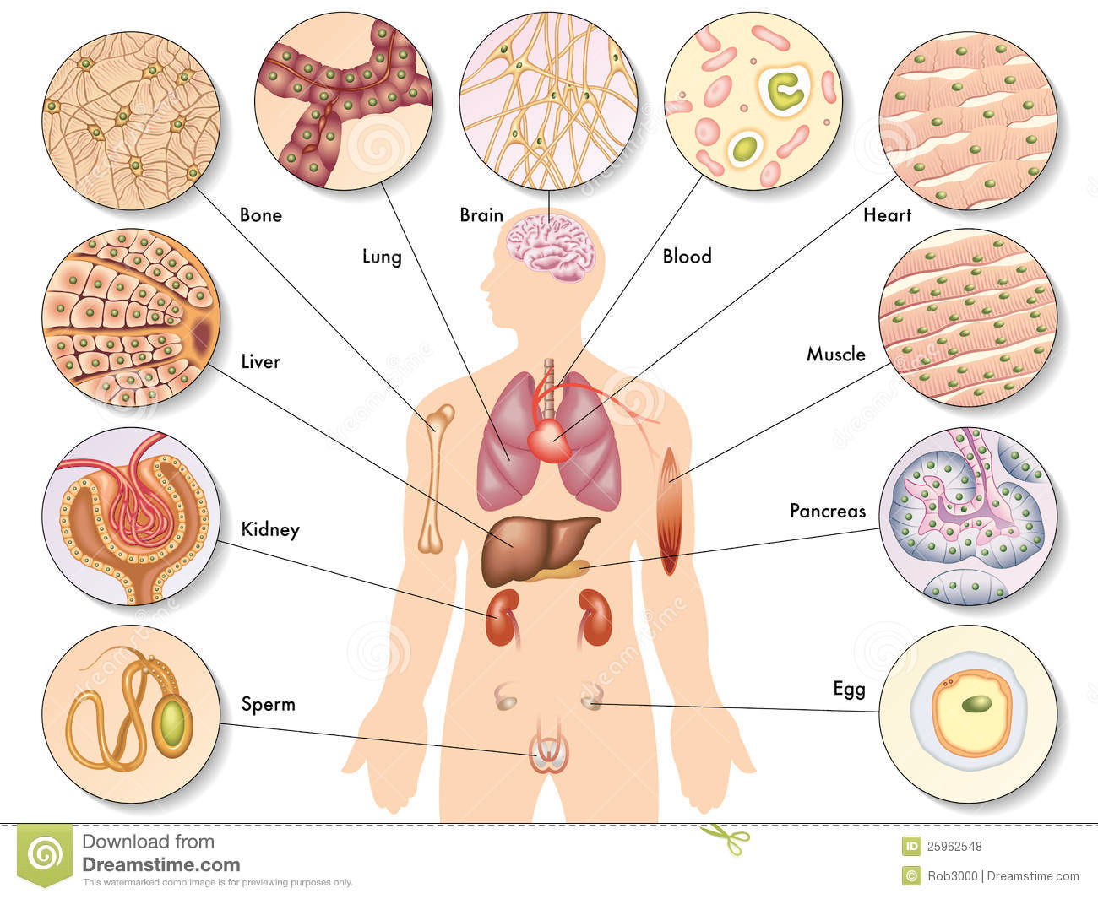
Cells are the building blocks of an organism.
They work together to keep an organism alive.
Cells exist in many sizes and shapes. They can be round, oval, short, with tail and so on.

Slide 4
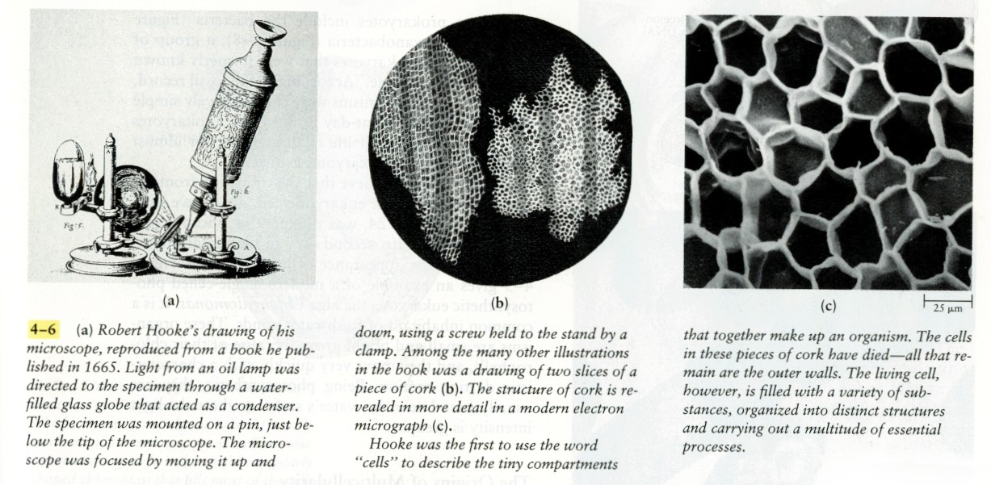
Who discovered it?
Cork cells as seen by Robert Hooke (British Scientist) using a microscope.

Slide 5
Using a Microscope

Slide 7
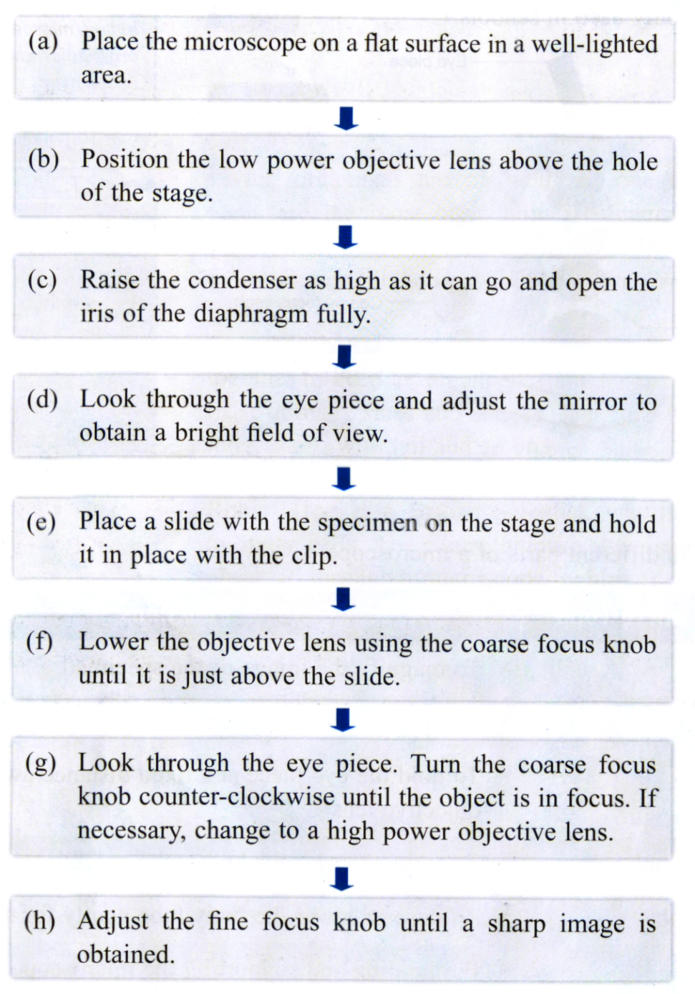
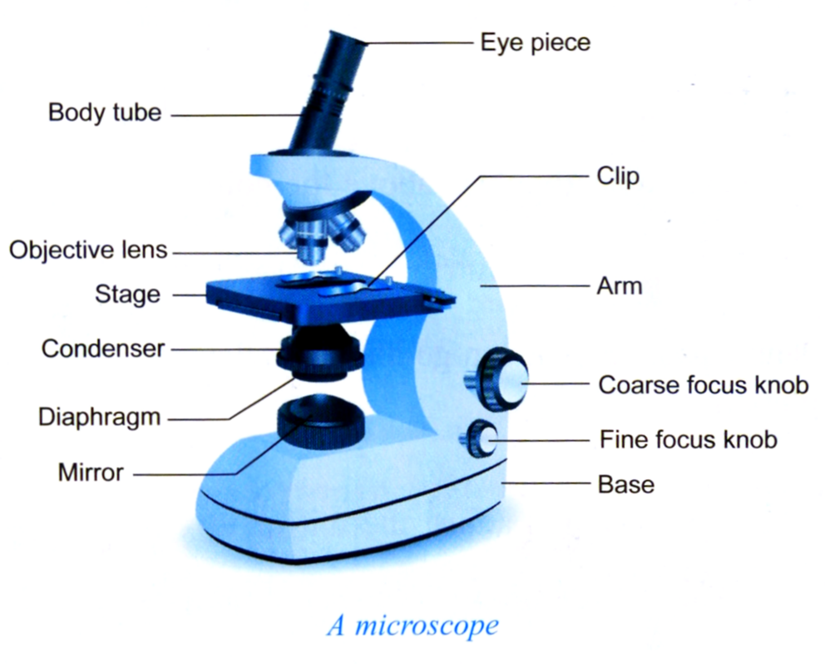
The correct way to use a compound light microscope:

