Slide 1
Changes in Global Climate
Atmosphere and Weather

Slide 2
Global Climate
It refers to the average climate on the Earth.
It refers to the general prevailing weather conditions of a region over a long period.
Thailand Climate: Tropical, average temperature 28°C, high humidity. Warm and rains a lot.

Slide 3
Global Warming
It is a gradual increase in the overall temperature of the earth's atmosphere generally attributed to the greenhouse effect caused by increased levels of carbon dioxide, chlorofluorocarbons, and other pollutants.

Slide 4
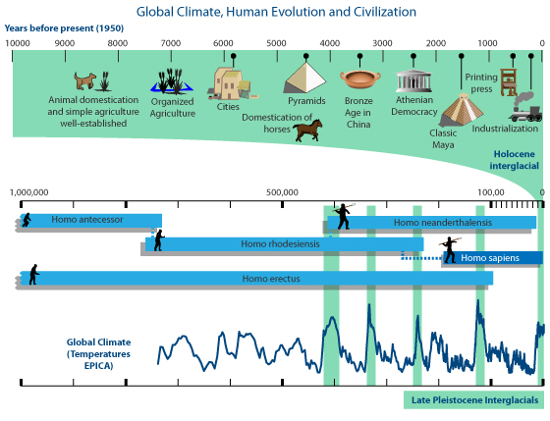

Slide 5
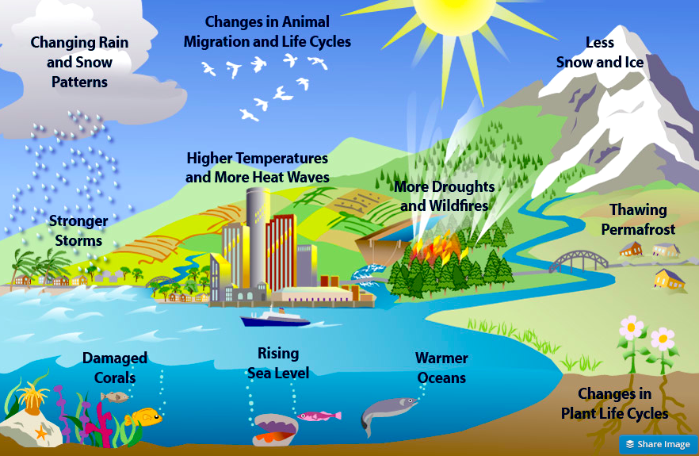

Slide 6
What We Can Do?
Reducing fossil fuel use
Planting more trees
Practicing 3R’s (reduce, reuse, recycle)
Conserving water

Slide 7
Air Quality Index
The AQI is an index for reporting daily air quality. It tells you how clean or polluted your air is, and what associated health effects might be a concern for you. The AQI focuses on health effects you may experience within a few hours or days after breathing polluted air.

Slide 8
What is PM 2.5 and 10?
The term fine particles, or particulate matter 2.5 (PM2.5), refers to tiny particles or droplets in the air that are two and one half microns or less in width. Like inches, meters and miles, a micron is a unit of measurement for distance. There are about 25,000 microns in an inch.
1 μm in: is equal to
SI units: 1×10−6 m

Slide 10
This diagram shows types and size distribution in micrometers of atmospheric particulate matter.

Slide 11
TEST YOURSELF
Name the factors that contribute to the increased amount of carbon dioxide in the atmosphere.
What is the function of carbon dioxide in the atmosphere?
How will global warming affect our environment?
Give one best solution in order to solve the air pollution in Thailand?

