Slide 1
Compound and mixture
Lesson 3

Slide 2
Classifying Matter
Element - a pure substance
Compound – 2 or more elements chemically combined
Mixture – 2 or more substances physically combined

Slide 3
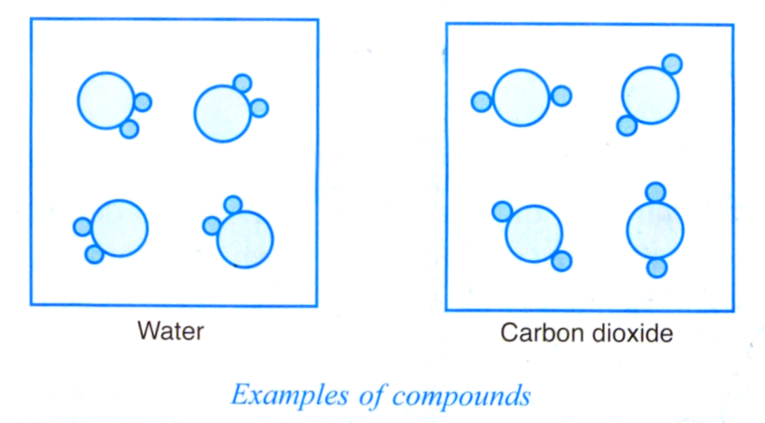
Compound is formed when two or more elements combine chemically in a chemical reaction. For example, water is formed when hydrogen reacts chemically with oxygen. Examples of compounds are water and carbon dioxide.

Slide 4
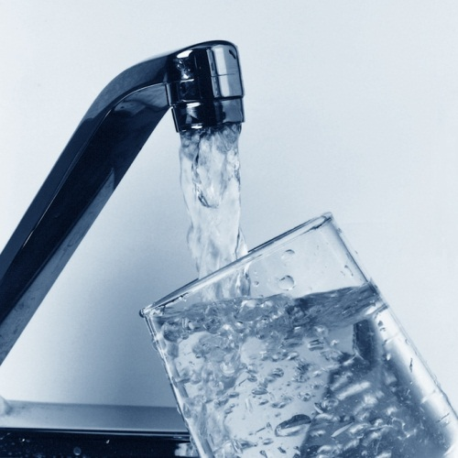
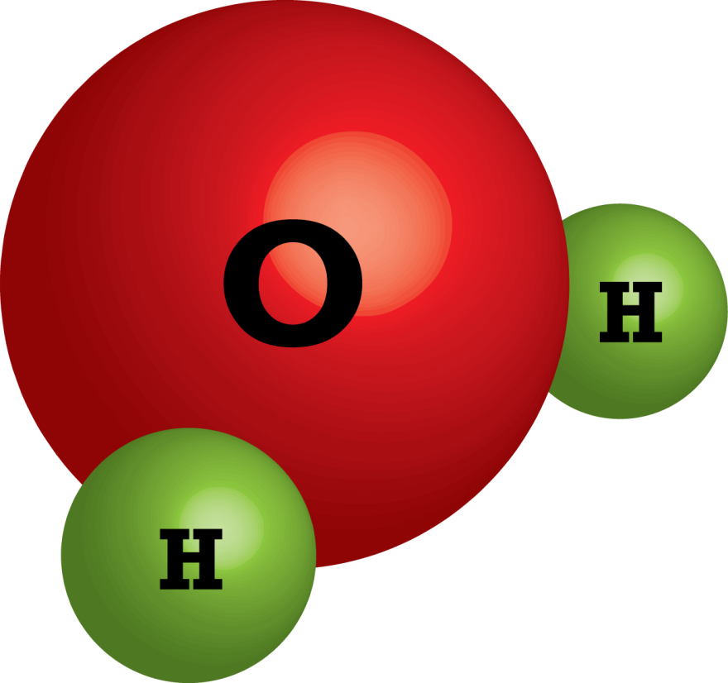
COMPOUND

Slide 5
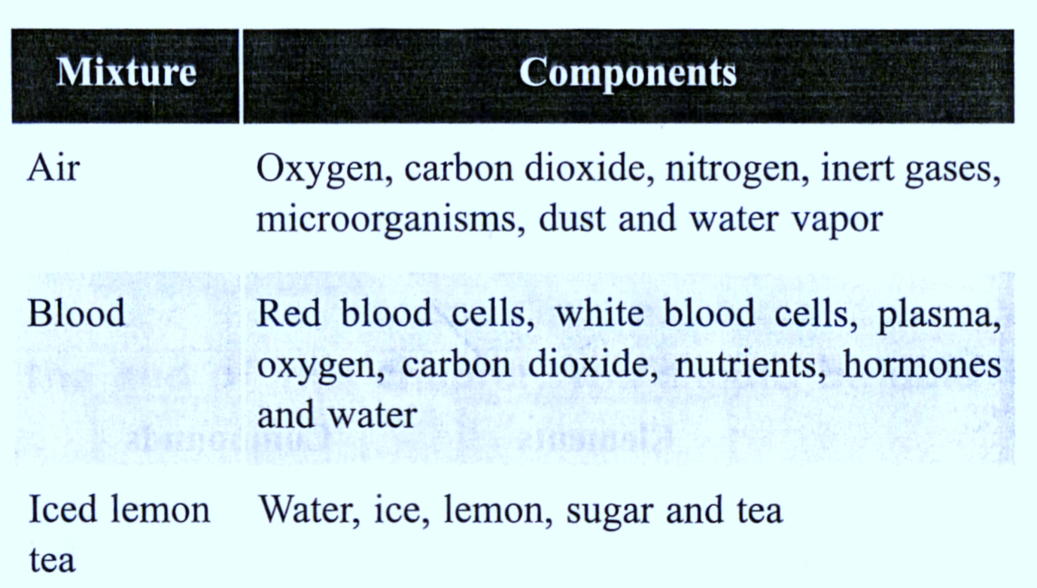
Mixture is made up of two or more components which are mixed physically. They may be mixed by stirring, shaking, or dissolving. Examples of mixtures are blood, air, and iced lemon tea.

Slide 6
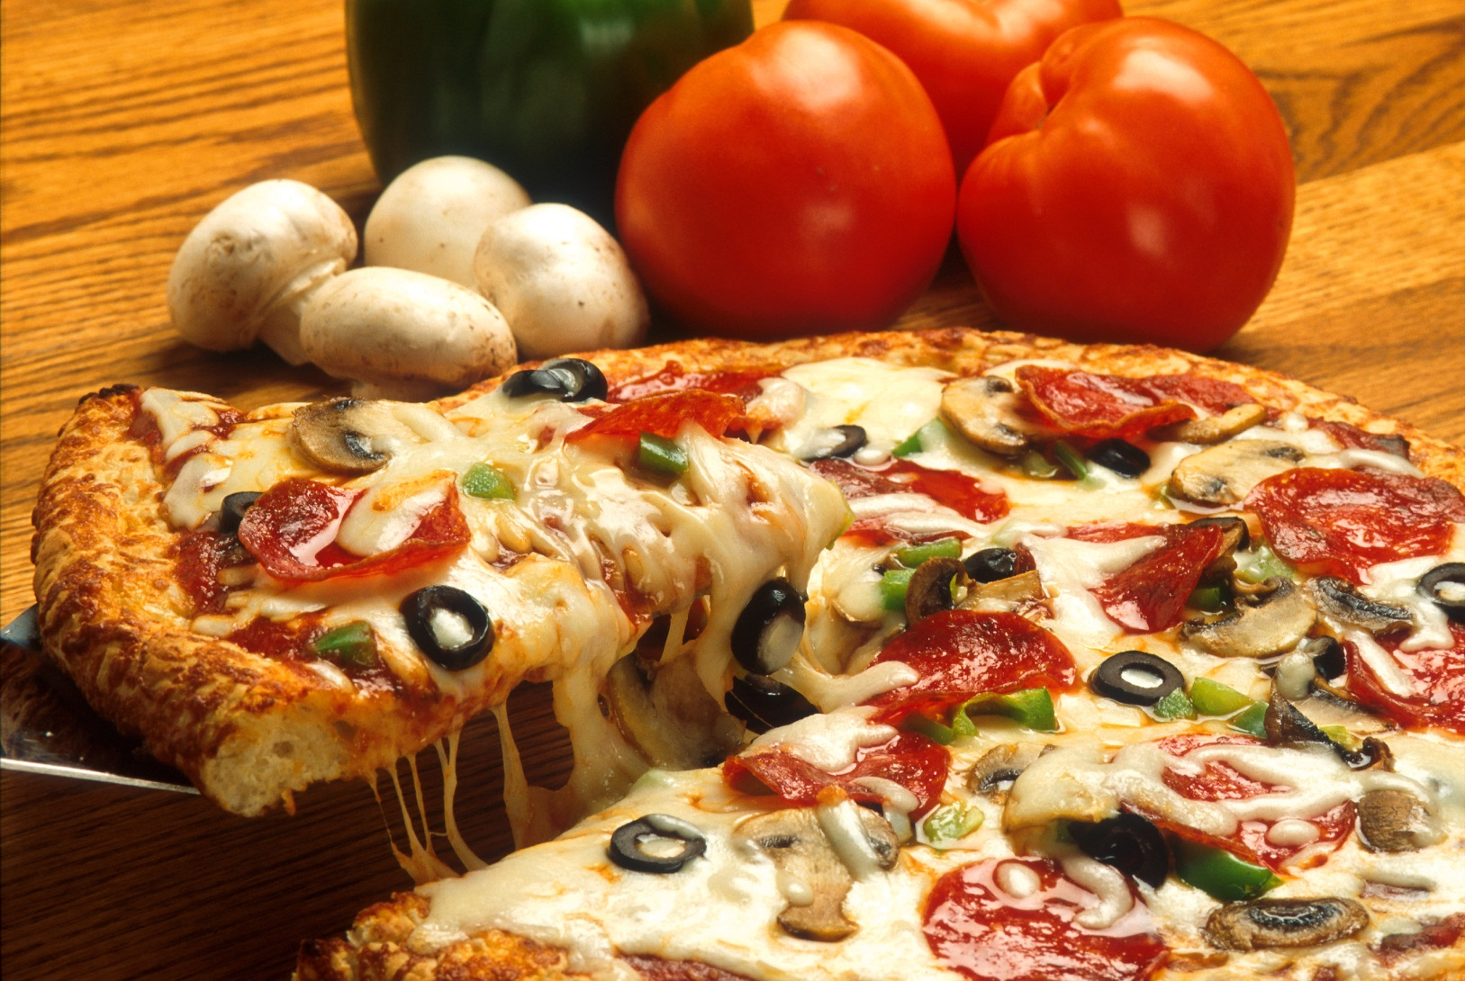
MIXTURE

Slide 7
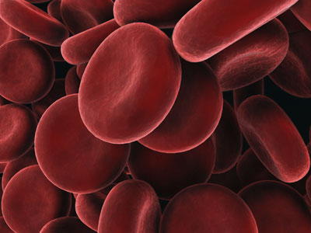
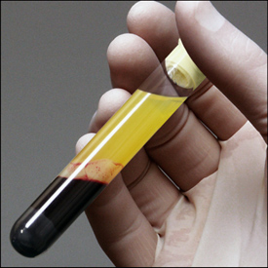
MIXTURE

