Slide 1
Ecosystem
Unit 1

Slide 2
Group of 4 Activity
What is Ecosystem?
How big and small is the ecosystem?
What is in the ecosystem that makes it an ecosystem?

Slide 3
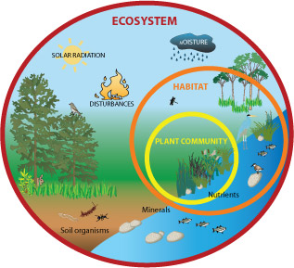
Ecosystem
Ecosystem – refers to the community of organisms living in the same habitat, together with the non-living environment.
Biotic (living things)
Abiotic (non-living things)
Habitat – a place where organisms obtain food, shelter, and protection.
Niche - the role and position a species has in its environment; how it meets its needs for food and shelter, how it survives, and how it reproduces.

Slide 4
Interdependence among Living Organisms
Species – organisms with common characteristics, can breed among themselves to produce fertile offspring.
Population – made up of a number of organisms of the same species.
Community – made up of many populations living together in a particular habitat. All fish, tadpoles, shrimps, water lilies, water weeds, frogs and snails make up the pond community.

Slide 5
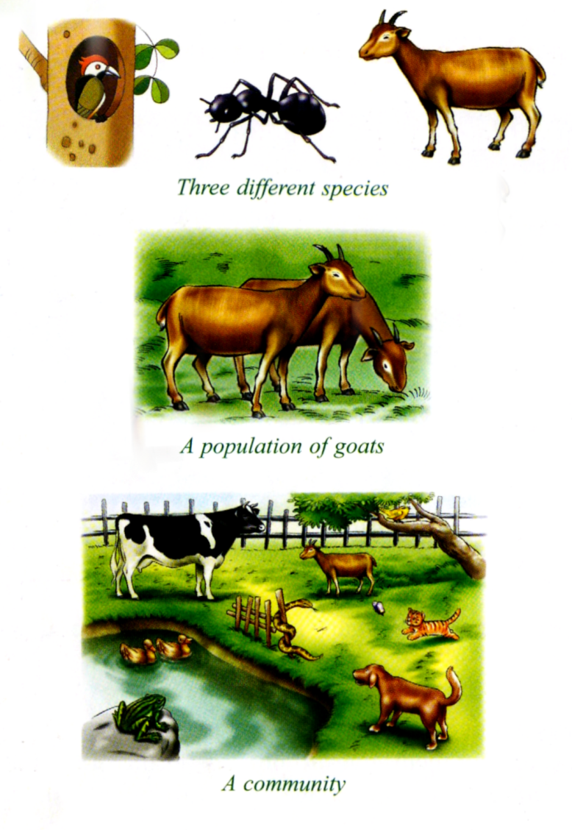

Slide 6
Types of Ecosystems
Natural Ecosystems & Man-made Ecosystems
Forest, marine, wetland, grassland, etc.
Natural ecosystems are mostly complex. There are many species living together in the same habitat and there are usually more than one habitat in an ecosystem.

Slide 7
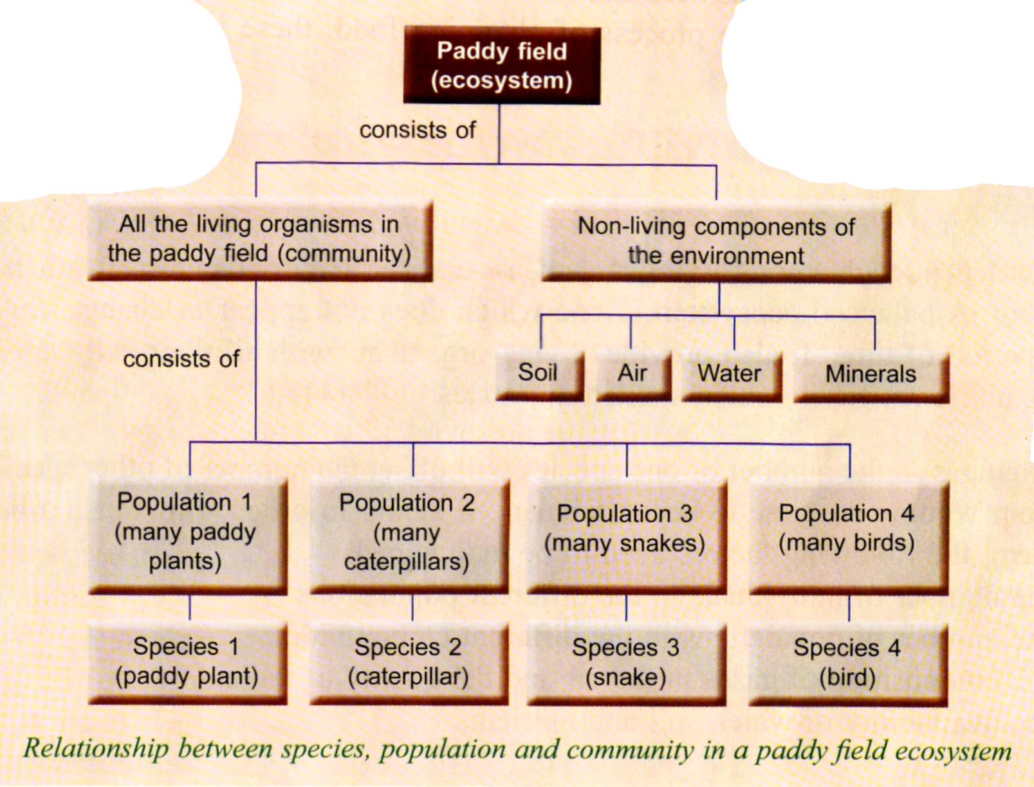

Slide 8
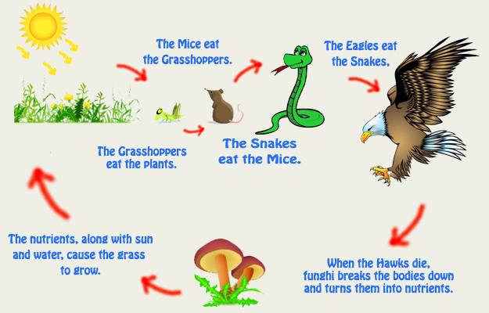
Interdependence of living organisms creates a balanced ecosystem

Slide 9
Test Yourself
1. Define each of the following:
Species
Population
Community
Habitat
Ecosystem
2. Why is the wetland considered as an ecosystem?

