Slide 1
Ecosystem
Unit 1: Lesson 2

Slide 2
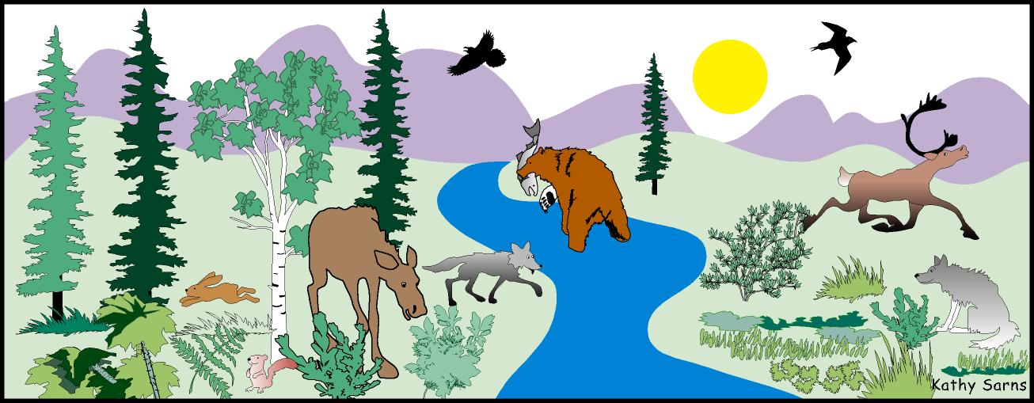
Interaction Between Living Organisms
Organisms cannot live alone.
Interaction controls the size of populations in a community
Interaction creates a balanced and stable environment.

Slide 3
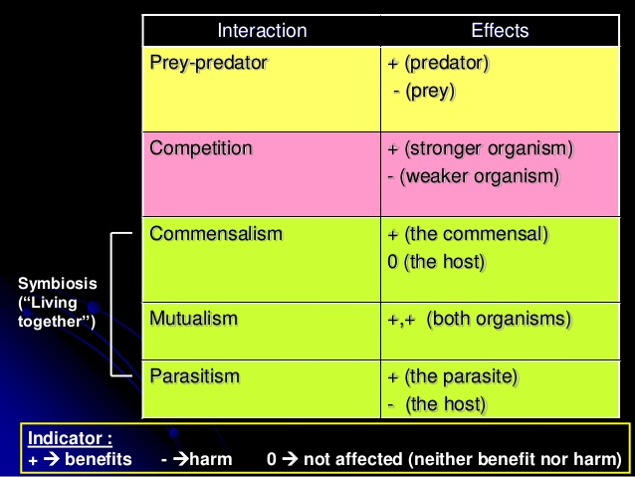
Types of Organisms Interactions
Prey-predator
Symbiosis
Commensalism
Mutualism
Parasitism
Competition

Slide 4
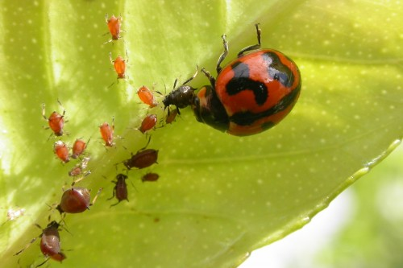
Biological Control
It is a method of controlling a certain population of organisms.
It makes use of the prey-predator interaction, parasitism, or competition relationship.
Using ladybird beetles to feed on aphids that destroy crops
Rearing fish in the pond to control the number of mosquitoes

Slide 5
Advantages & Disadvantages

Slide 6
Test Yourself
What type of interaction occurs between organisms?
Lion – antelope
Sea anemone – hermit crab
Human – head lice
What is commensalism?
How does a parasite differ from a predator?

Slide 7
Answers
Prey-predator, mutualism, parasitism
Commensalism is a relationship between two organisms in which one organism benefits and the other organism is unharmed.
A predator kills to obtain food whereas a parasite does not kill the host organism to benefit. In fact, the death of the host usually results in the death of the parasite too.

