Slide 1
Ecosystem
Unit 1: Lesson 3

Slide 2
Food Web Groups

Slide 3
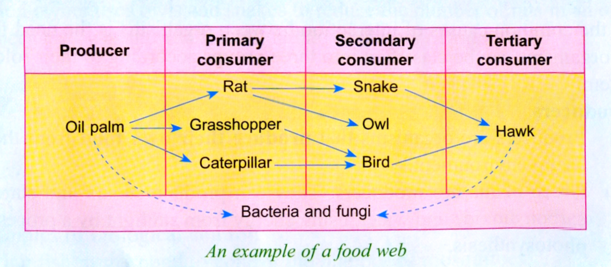
Food Chain & Food Web

Slide 4
Pyramid of Numbers

Slide 5
Test Yourself

Slide 6
Answers

