Slide 1
HEAT
Lesson 2: Effects of Heat on Matter

Slide 2
Effects of Heat on Matter
Expansion or Contraction
Changes in Temperature
Changes in States of Matter

Slide 3
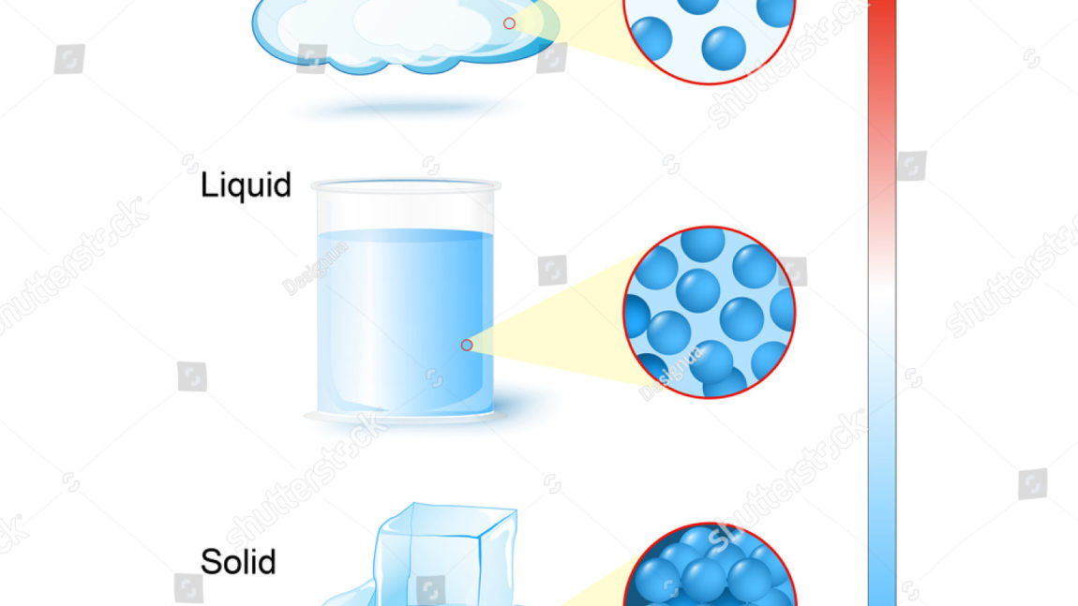
A. Expansion and Contraction of Matter
Expands when heated
Contacts when cooled
NOTE: The particles themselves do not expand or contract when heated or cooled. It’s the increase of heat pushing the atoms far apart or the decrease of heat pulling them closer to each other.

Slide 4
Group Roleplay (5 minutes)
Group yourselves into 6 members and choose at least 3 Uses of Expansion and Contraction of Matter. Think of a profession that applies them in daily life. After the roleplay, write and explain them in your notebooks.

Slide 5
Uses of Expansion and Contraction of Matter
Mercury in a thermometer
Bimetallic Strip in a fire alarm, thermostat, thermometer
Metallic tyres
Removing metal lids
Fixing axle into hub of a wheel
Rivets
Railway tracks
Concrete roads
Metal bridges
Cables

Slide 6
Changes in temperature
The increase and decrease of temperature when an object is heated or cooled depends on the following:
Mass of the object
The substance the object is made from
The amount of energy transferred

Slide 7
SPECIFIC HEAT CAPACITY
The specific heat capacity of a substance is the amount of heat required to increase its temperature of 1 kg of the substance by 1ºC. Different substances have different specific heat capacities. Unit is J/kg ºC
Substances | Specific heat capacity (J/kg ºc)
water | 4,200
copper | 387
glass | 840
mercury | 139
gold | 129
iron | 452

Slide 8
Water has the specific heat capacity of 4,200 J/kg ºC. In order to increase the temperature of 1 kg of water by 1 ºC, 4200 J of heat is needed.

Slide 9
Quantity of heat gained or lost by an object
Q = mcθ or mc∆T
Where,
Q = heat gained or lost in joules, J
m = mass of the object in kg
c = specific heat capacity in J/kg ºc
θ = change in temperature in ºC

Slide 10
Example 1
How much energy must be provided to raise the temperature of 2 kg of water from 25ºC to 35ºC?
Solution:
Mass, m = 2 kg
Specific heat capacity of water, c = 4200 J/kg ºC
Change in temperature θ = 35-25 ºc = 10 ºc
Q = mcθ
= 2 x 4200 x 10
= 84,000 J

Slide 11
EXAMPLE 2
1 kg of water with the temperature of 15 ºC is placed in a refrigerator. What is its temperature after 29,400 J of heat has been removed from it?
Solution:
Mass, m = 1 kg
Specific heat capacity of water, c = 4200 J/kg ºC
Heat removed, Q = 29,400 J
θ = Q/mc = 29,400/1x4200 = 7ºC
Final Temperature = 15-7 = 8ºC

Slide 13
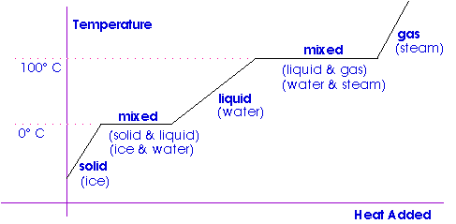
Changes in states of matter
When heat is continuously supplied to an object, the temperature of the object will increase.
It will increase to a reading where it will remain constant.
At this moment the object changes its state.

Slide 14
SPECIFIC LATENT HEAT
When 1 kg of a substance is melting and boiling, it absorbs heat without an increase in the temperature.
The heat absorbed is known as specific latent heat.
Therefore, the specific latent heat of a substance is the amount of heat required to change the state of matter of 1 kg of the substance at a constant temperature. Unit is J/kg.

Slide 15
Specific latent heat
When the heat being absorbed by the substance is enough to increase the kinetic energy of the particles to overcome the force of attraction between the particles, then change of state will take place.
The quantity of heat gained or lost when a substance changes its states
Q = ml
Q = heat gained or lost joules, J
m = mass of the object in kg
l = specific latent heat in J/kg

Slide 16
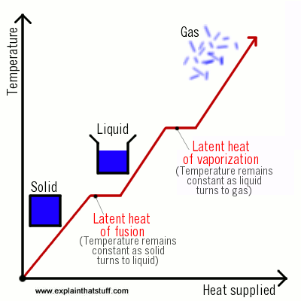
Specific latent heat: Vaporization & fusion

Slide 17
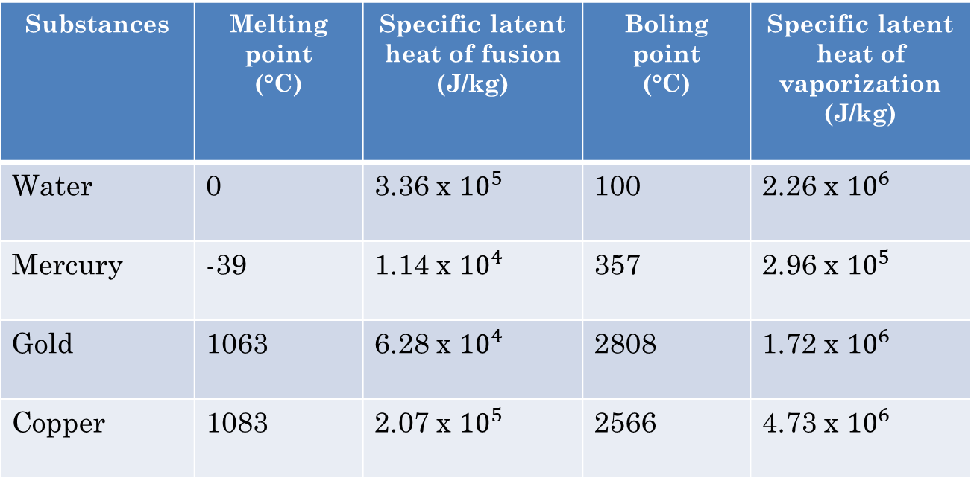
Substances | Melting point (°C) | Specific latent heat of fusion (J/kg) | Boling point (°C) | Specific latent heat of vaporization (J/kg)
Water | 0 | 3.36 x ${10}^{5}$ | 100 | 2.26 x ${10}^{6}$
Mercury | -39 | 1.14 x ${10}^{4}$ | 357 | 2.96 x ${10}^{5}$
Gold | 1063 | 6.28 x ${10}^{4}$ | 2808 | 1.72 x ${10}^{6}$
Copper | 1083 | 2.07 x ${10}^{5}$ | 2566 | 4.73 x ${10}^{6}$

Slide 18
EXAMPLE 3
How much energy is required to change 0.65 kg of ice into water at 0°C?
Solution:
Mass, m = 0.65 kg
Specific latent heat of fusion of water, l = 3.36 x ${10}^{5}$ J/kg
Heat needed, Q = ml = 0.65 kg x 3.36 x ${10}^{5}$ J/kg = 2.18 x ${10}^{5}$ J

Slide 19
EXAMPLE 4
6.78 x ${10}^{6}$ J of heat energy is removed from a mass of steam at 100 °C. What is the mass of water produced?
Solution:
Specific latent heat of vaporization of water, l = 2.26 x ${10}^{6 }$J/kg
Heat removed, Q = 6.78 x ${10}^{6}$ J
Q = ml
m = Q/l = 6.78 x ${10}^{6 }$J / 2.26 x ${10}^{6}$ J/kg = 3 kg

Slide 20
Application of specific latent heat

Slide 21
Answer TEST YOURSELF 6.2

