Slide 1
ELECTRICITY
2nd half, 1st Semester, Unit 4

Slide 2
Introduction to electricity
LESSON 1

Slide 3
Sources of Electricity
Our main source of electrical energy comes from huge generators in power stations.

Slide 4
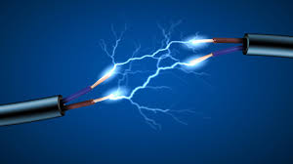
Electricity
Electricity is known as the flow of electric current in a conductor.
Electric current is defined as the rate of flow of charges through a conductor.

Slide 5
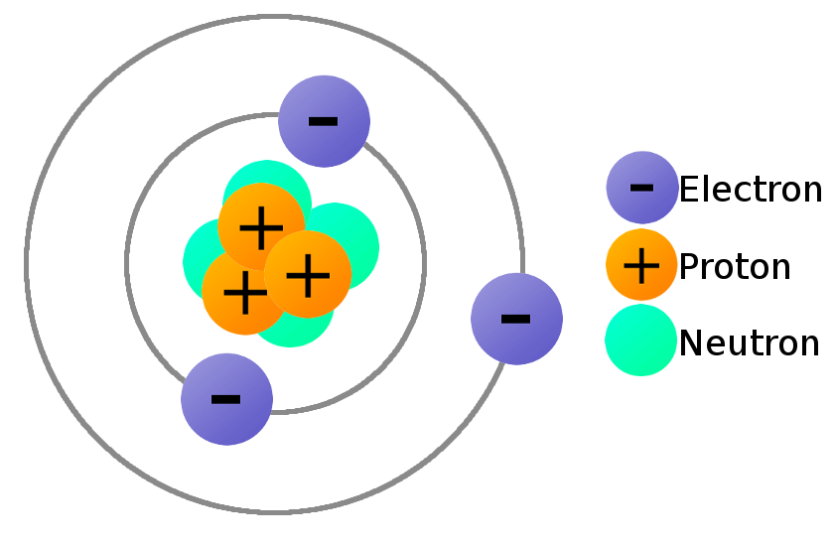
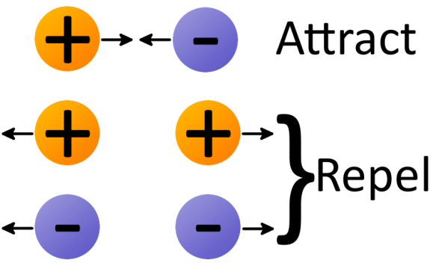
Electrical Charges
Like charges repel, and opposite charges attract.

Slide 6
Conventional Current VS. Electron Flows

Slide 7
Terminologies
Voltage is the potential difference across two points or the electrical energy supply needed to move a unit of charge from one point to another.
Electrical current is the rate of charges through a conduction.
Resistance is the property of a material that resists the flow of electric current through it.
Andre-Marie Ampere discovered the unit for electric current (ampere).
Alessandro Volta discovered the unit for voltage (volt).
The unit for resistance (ohm) is named after German scientist Georg Simon Ohm.

Slide 8
Polarization
Electro static Induction – is a method to create or generate static electricity in a material by bringing an electrically charged object near it. This causes the electrical charges to be redistributed in the material, resulting in one side having an excess of either positive (+) or negative (−) charges.

Slide 9
Test Yourself

