Slide 1
ELECTROMAGNETIC WAVES
Mechanical and electromagnetic

Slide 2
2 groups of waves
MECHANICAL
ELECTROMAGNETIC
A wave that is not able to travel through a vacuum.
It needs a medium such as air and water.
Sound and water waves
A wave that can travel through a vacuum.
It contains an electric field and magnetic field.
Travels at the speed of light which is 3 x 10⁸ m/s or 299 792 458 m / s or approximately 300,000 km/s

Slide 3
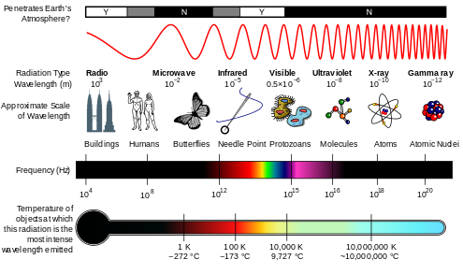
ELECTROMAGNETIC SPECTRUM
There are many types of electromagnetic waves based on their wavelengths or frequencies.

Slide 4
Ionizing radiation
is a form of energy that acts by removing electrons from atoms and molecules of materials that include air, water, and living tissue. Ionizing radiation can travel unseen and pass through these materials.

Slide 5
Damaging Effects

Slide 6
Laser Beams
LASER stands for Light Amplipication by Stimulated Emission of Radiation
A device that gives out a highly concentrated narrow beam of electromagnetic waves with a wavelength between 10⁻⁷ to 10⁻⁵ m.
Laser beams can made up of infrared rays, visible light, and ultraviolet rays.
They are very useful.
LASER BEAMS USES
Scalpel for surgeries
Reading CDs
Cutting, drilling, and engraving metals
Barcode readers
Calculating distances
Fiber optic cables to carry information
Laser printing
Special effects in entertainment industry

Slide 7
TEST YOURSELF
State the members of the electromagnetic waves and one of their uses.
State the common characteristics of the members of the electromagnetic waves.
Why are some electromagnetic waves dangerous?
What are laser beams? Name three uses of laser beams?

