Slide 1
gmo
Genetically Modified Organism

Slide 2
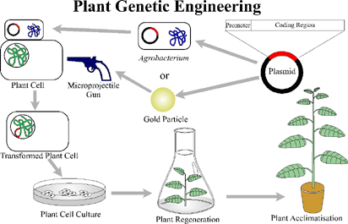
What is it?
Are organisms in which their genetic materials have been altered in a way that does not occur naturally to contain a segment of DNA from other organisms such as bacteria, viruses, animals, and plants.
Usually a segment of DNA from a different species genetically engineered to another species to create a new desirable trait.

Slide 3
Benefits
Medicines such as insulin from genetically modified yeast.
Vaccines such as for hepatitis B.
Increase yield of food crops and live stocks

Slide 4
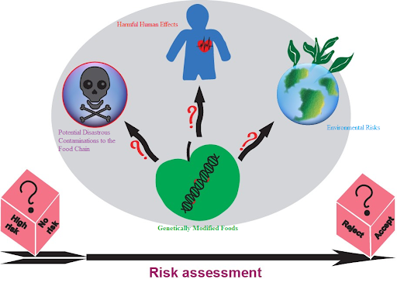
Risks
Effects of consuming GMOs for a long period of time.
Might trigger allergic foods for humans.
Might harm the survival of other organisms in the natural environment.
Might cause emergence of new diseases.

Slide 5
Test Yourself
1. What are GMOs?
What are the benefits of GMOs?
Why are some people worried about GMOs?

