Slide 1
HEAT
Lesson 1: Heat as a Form of Energy

Slide 2
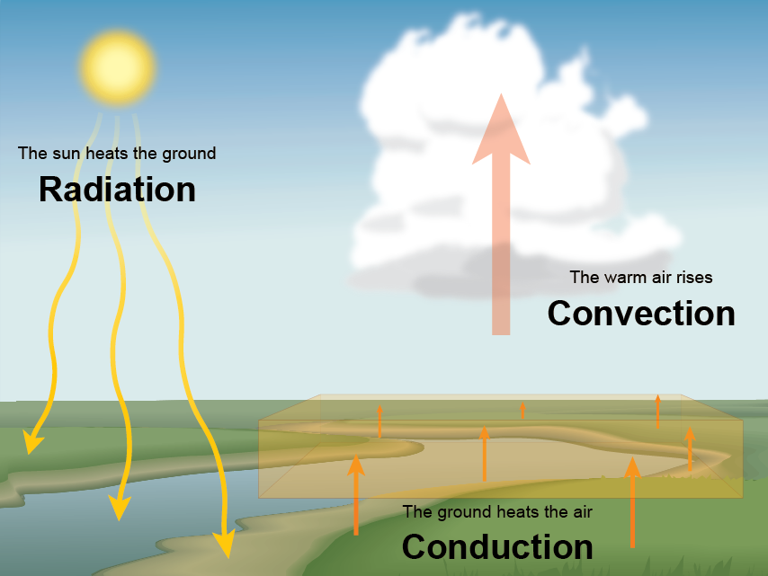
Heat as a form of Energy
Energy is the ability to do work. Therefore, we can use heat to do work!

Slide 3
Other Sources of Heat
Rubbing or Friction
Burning
Electricity
Bending metal
Chemical reaction
Collision

Slide 4
Uses of Heat in Our Daily Life
Cook food
Dry clothes
Boil water
Produce steam to generate electricity
Dry food for preservation
Warm ourselves

Slide 5
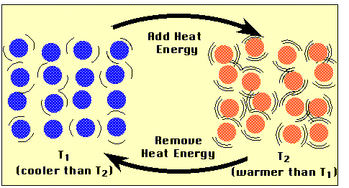
Heat and Temperature
Heat is a form of energy. An object becomes hot when it absorbs heat or becomes cold when an amount of heat is removed. It is measured in Joules (J)
Temperature is the degree of hotness or coldness of an object. It is measured in Celsius, Fahrenheit, or Kelvin.

Slide 6
LAB ACTIVITY
Heat and Kinetic Energy
Materials
Paper Cup
A handful of Sand
Any plastic or thick paper to cover the paper cup

Slide 7
Classwork
Answer the following:
Textbook: Test Yourself 6.1, page 124
Workbook: Page 74-75, 6.1

