Slide 1
HOW TO STUDY SCIENCE
Lesson 1

Slide 2
WHAT IS AND WHAT IS NOT SCIENCE
SCIENCE IS…
SCIENCE IS NOT…
the study of nature and its effects on humans and the environment such as the refraction phenomenon, the melting ice, object falling to the ground and growth in human
the study of the natural world.
Anything that is beyond natural.
Examples: God, ghost, legend, myth, fairytales, etc.

Slide 3
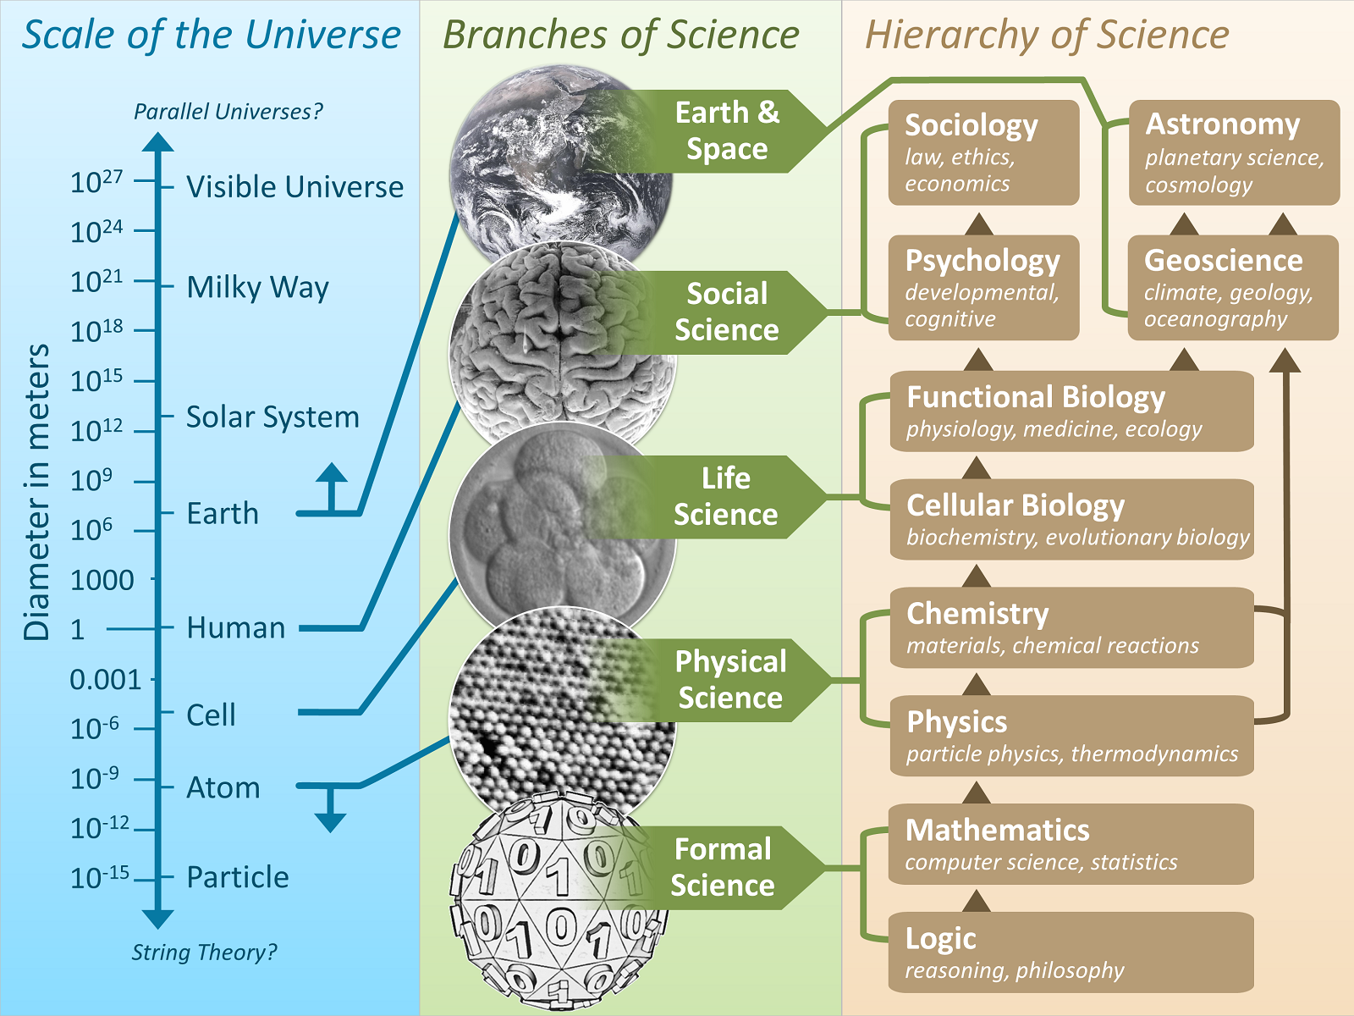

Slide 4
CAREERS OF SCIENCE
Doctor – a person who has been trained in and practices medicinal science.
Veterinarian – an animal doctor.
Pharmacist – a person who dispenses medicinal drugs and advices on their uses.
Engineer – a skilled person who designs, builds or maintains engines, buildings, bridges or roads.
Architect – a person who designs buildings and advices on their construction.
Chemist – a person trained in chemistry.

Slide 5
21st century science careers
Google it!
Search at least 5 new careers (21st century) and 5 old careers that are related to science or in a field of science, and describe each of them. (ex. 1. Nanotechnologist - )
Among the ten, choose one or two careers that you want to be when you grow up. Tell us the reason why you choose this. If there’s none, then share to us what career you have in mind and explain why.

Slide 6
Some areas of science
Biology – the study of life.
Physics – the study of matter.
Chemistry – the study of the composition and chemical properties of substances.
Astronomy – the study of planets and stars in the universe.
Geology – the study of rocks, minerals and the structure of the earth.
Meteorology – the study of weather and climate.
Biochemistry – the study of chemical processes in living organisms.

Slide 7
What areas of science you need to master?
Based on your chosen career, what areas of science that you need to be really good at? Explain why.
Write down at least 5 steps/ways in order to achieve your dream career. How you are going to get there (maybe 10 to 15 years) from now?

Slide 8
Attitude of science
Curious
Open-minded
Humble
Creative
Imaginative
Objective
Truthful
Perseverance
Responsible
Teamwork

Slide 9
Science & technology
1. What is your understanding about technology?
2. What is the difference between science and technology?
3. What is the relationship of science and technology?
4. Give at least 2 useful and 2 harmful effects of technology to humans.

Slide 10
Laboratory science
Apparatus & safety

Slide 13
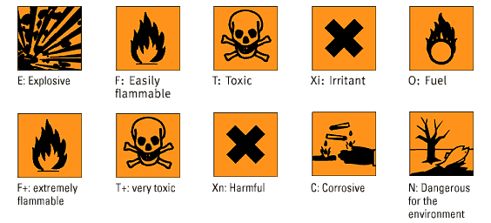

Slide 16
Create 3 scientific questions about apple/s
1.
2.
3.

Slide 17
Variables
-Conditions that influence the results of the experiments
Controlled Variable – is what will be measured; it's what the investigator thinks will be affected during the experiment. It is also known as the constant variable.
Independent Variable – is what varied during the experiment; it is what the investigator thinks will affect the dependent variable. It is also known as the manipulated variable.
Dependent Variable – is what will be measured; it's what the investigator thinks will be affected during the experiment. It is also known as the responding variable.

Slide 18
Can plant grow without sunlight?

Slide 19
Forming hypothesis & identifying the variables based on apples
Example:
Selected Scientific Question: Can plant grow without sunlight?
Hypothesis: No, plant cannot grow without sunlight
Variables:
Independent/Manipulated: Sunlight
Dependent/Responding: Plant growth
Controlled/Constant: same species of plants, time, soil, temperature, humidity, etc.

Slide 21
Methods/procedure
Selected Scientific Question: Does an ice cube melt faster in hot water or in cool water?
Hypothesis:
Variables:
Independent/Manipulated:
Dependent/Responding:
Controlled/Constant:
Safety Rules:
Materials:
Procedure/Steps:

Slide 22
Activity & Results
Test hypothesis or conduct the experiment
Prepare the materials on the table
Be aware of safety rules
Design a independent and dependent variables table Carefully follow the steps
Take at least 1-2 photos or a short clip video 10-15 sec.

