Slide 1
MATERIALS
POLYMERS, CERAMICS, COMPOSITE MATERIALS

Slide 2
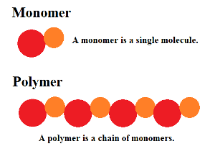
POLYMERS
Polymers are substances with large molecules made of many smaller molecules (monomers) of the same kind.

Slide 3
POLYMERS
NATURAL
SYNTHETIC
rubber, starch, proteins, fats, DNA, wool, silk
Plastics (polychloroethene or PVC, polythene or PE, and polypropene, or PP)
Synthetic fibers (nylon and terylene)
Synthetic rubbers

Slide 4
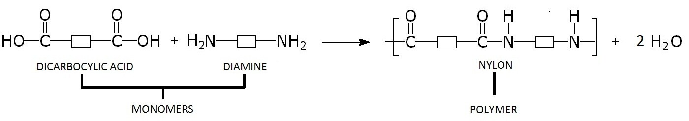
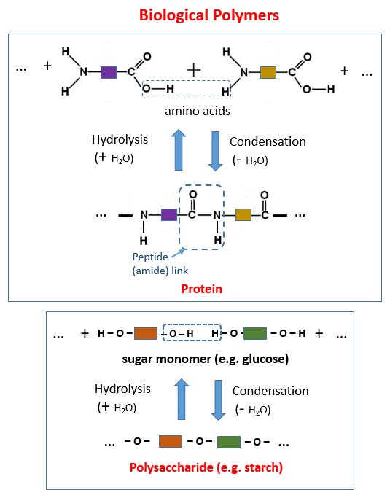
Natural
Synthetic

Slide 5
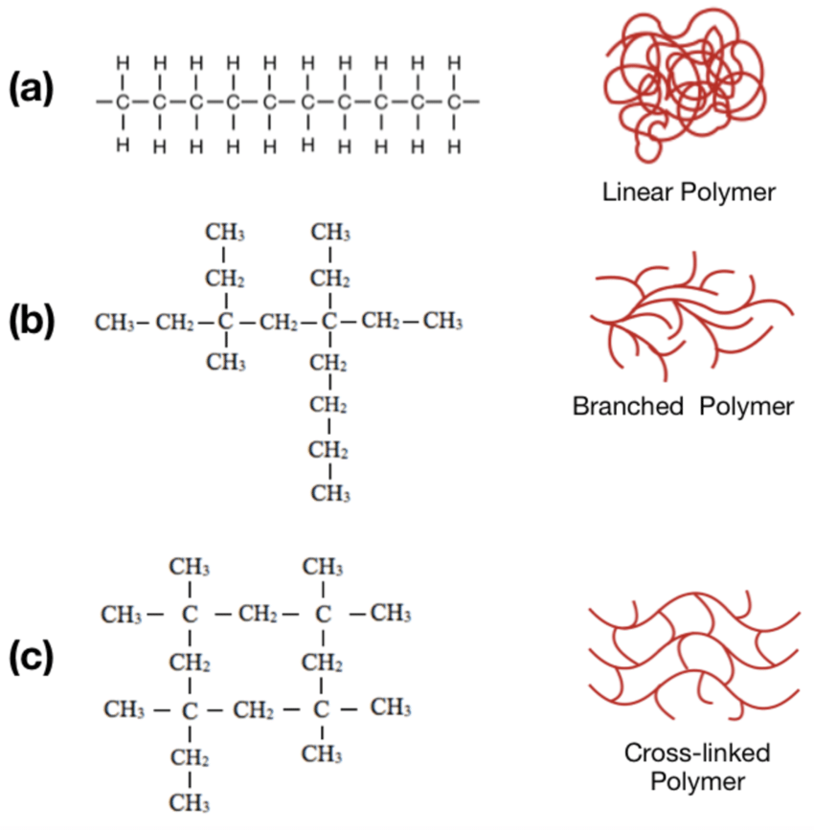
Properties of Synthetic Polymers
The properties of the polymer depend on its structure.
Usually, long polymers are stronger because they are more tangled up.
A highly-linked polymer is harder and more difficult to melt.
Thermosets – cannot be reprocessed into different shapes upon heating (cross-linked)
Thermoplastics – can be re-shaped upon heating (linear and branched)

Slide 6
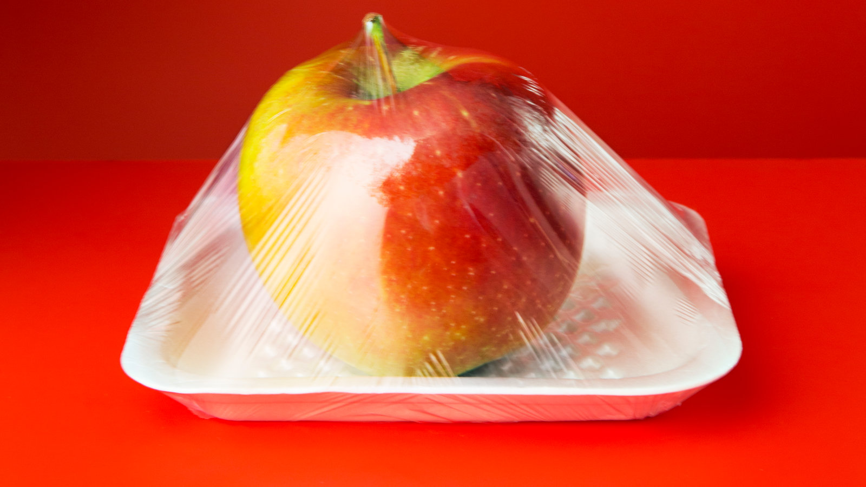
Properties of Most Synthetic Polymers
Inert to chemicals
Both thermal and electrical insulators
Light and vary in strength and hardness
Molded into various shapes
Made with limitless of properties and colors

Slide 7
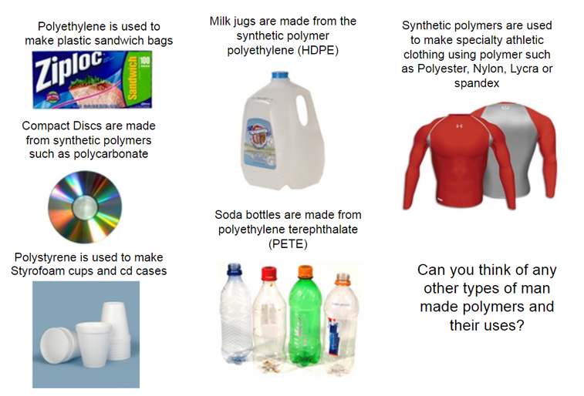
Use of Synthetic Polymers

Slide 8
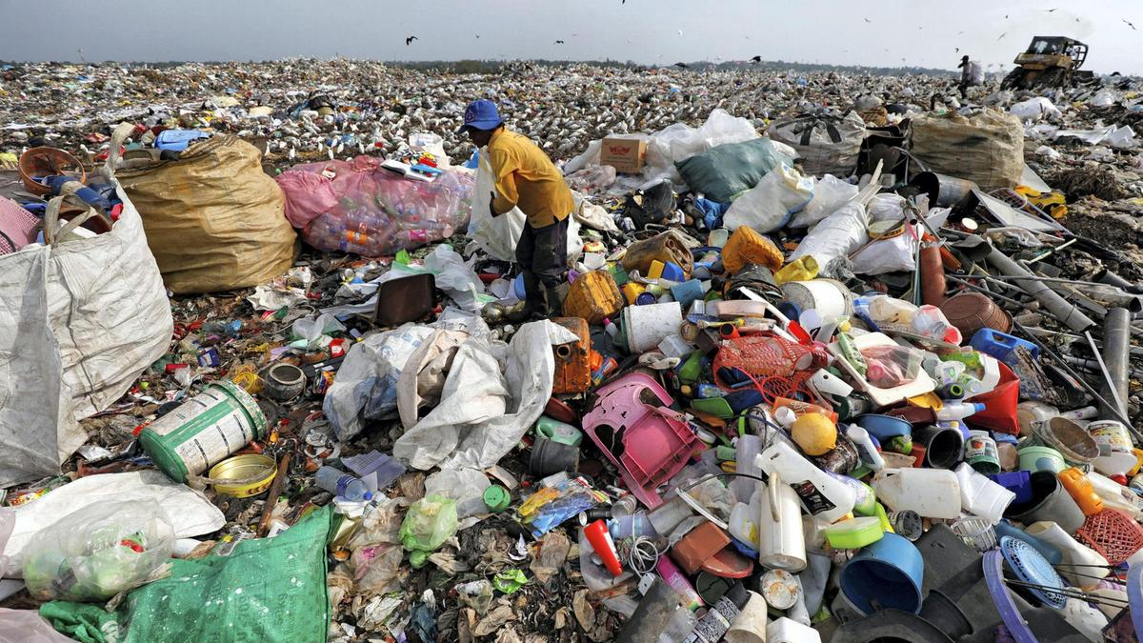
Problems of Using Synthetic Polymers

Slide 9
Test Yourself 3.1
Define the following terms.
  polymer
  Monomer
  Polymerization
List two uses of synthetic polymers
What are the advantages and disadvantages of using synthetic polymers? Give 2 examples.

