Slide 1
MATTER
Unit 2

Slide 2
What is matter?
Anything that has mass and occupies space.
All living and non-living things around us are made up of matter. Air, water, glass, sugar, and rope are example of matter.
What is not Matter? ENERGY

Slide 3
STATE OF MATTER
Solid – has volume and shape
Liquid – has volume, no definite shape
Gas – no definite volume and shape

Slide 4
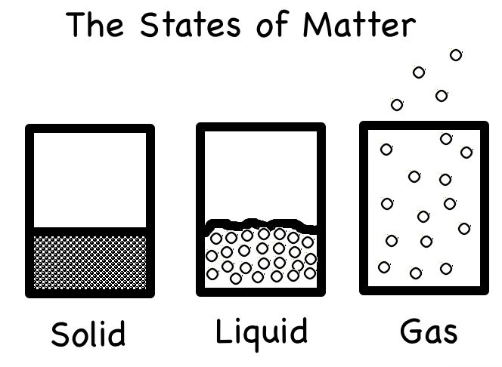

Slide 6
Arrangement & movement of particles in matter
Characteristics | Solid | Liquid | Gas
Arrangement of particles | Very close together | Close together | Far apart
Spaces between particles | Very small space | Small spaces | Big spaces
Movement of particles | Cannot move freely (vibrate) | Can move freely, collide each other | Can move freely, collide each other at high speeds

Slide 7
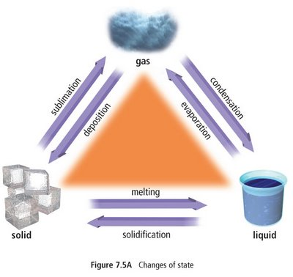
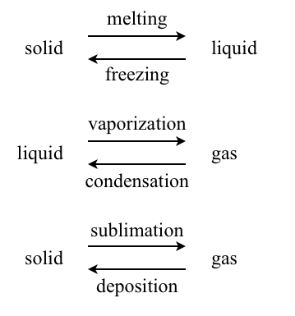
Change of state

Slide 8
CHANGE OF STATE
Change | From | To | Heat | Example
Sublimation | Solid | Gas | Added | Moth balls disappear when left in cupboard for a few days.
Deposition | Gas | Solid | Removed | Iodine vapor will turn into needle crystals of black iodine.
Boiling/ Evaporation | Liquid | Gas | Added | Rain water dries up under the Sun
Melting | Solid | Liquid | Added | Ice cubes turn to water at room temperature.
Freezing/ Solidification | Liquid | Solid | Removed | Water turns into ice when left in freezer.
Condensation | Gas | Liquid | Removed | Drops of water form on the mirror when taking a hot bath.

Slide 9
Work assignment
CLASSWORK:
Write in your notebook:
What is matter?
What are the three states of matter? Describe each one of them.

Slide 10
Read and answer
Draw a table that shows the difference between Solid, Liquid and Gas
What is the difference between sublimation and deposition?

