Slide 1
MEASUREMENTS
LESSON 2

Slide 2
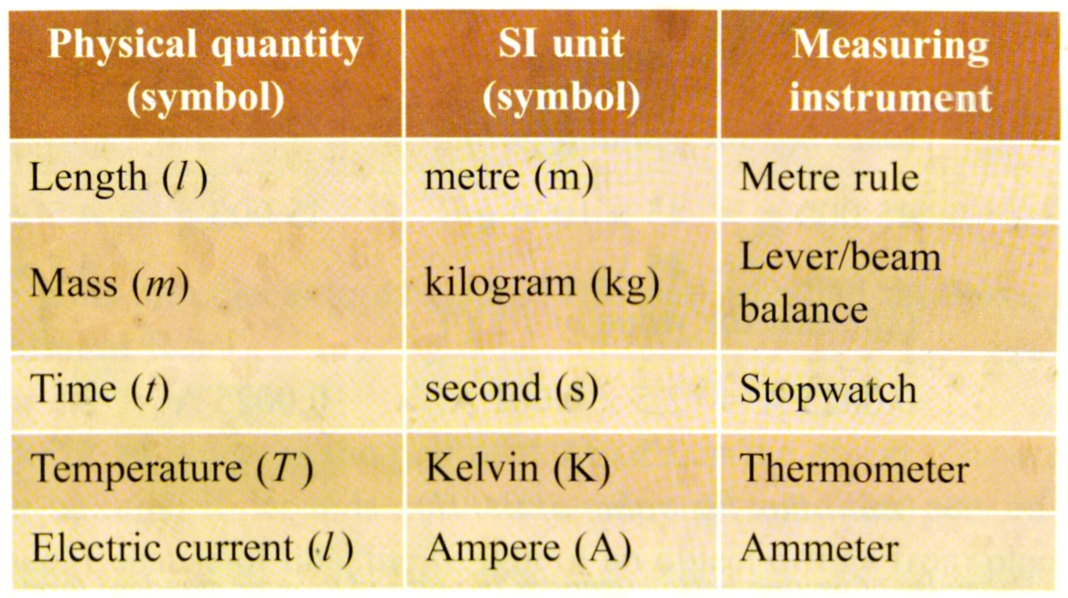
Physical Quantities and their Units
PHYSICAL QUANTITY
  refers to a quantity that can be measured.
  Measured in SI Units which means International System of Units used all over the world

Slide 3
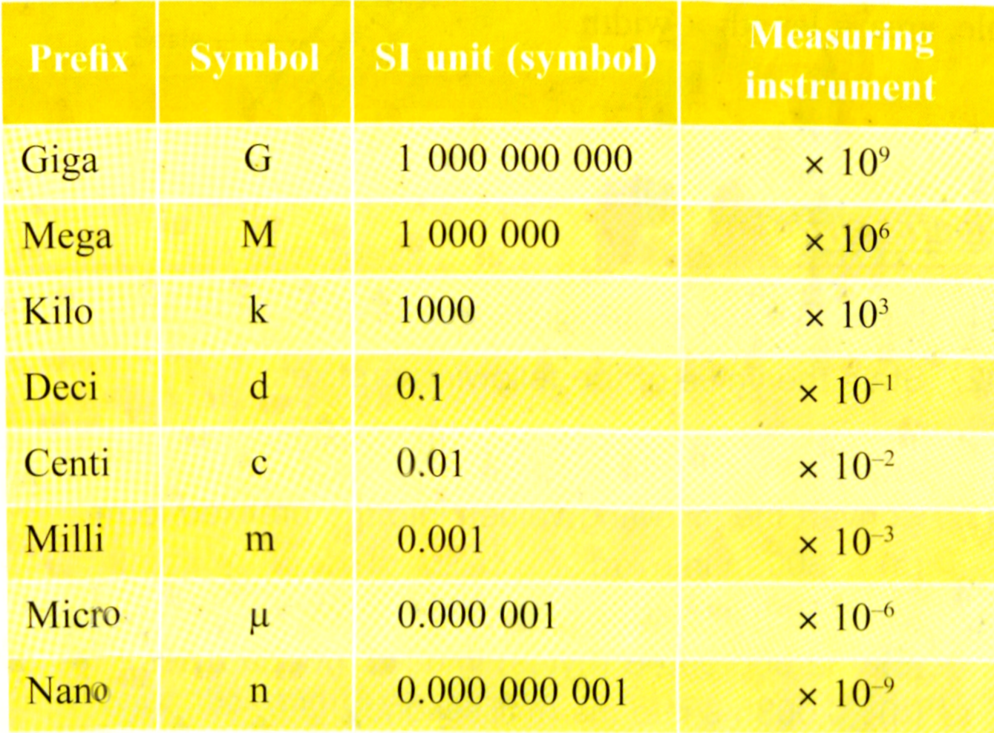
PREFIX
A prefix is added to a unit to change the value of the unit.
Prefixes are used in the SI unit to state a very small or a very big value.
We can write a quantity in the prefix form or standard form.
Giga, mega, and kilo are used for big quantities. Deci, centi, milli, micro and nano are used for small quantities.

Slide 4
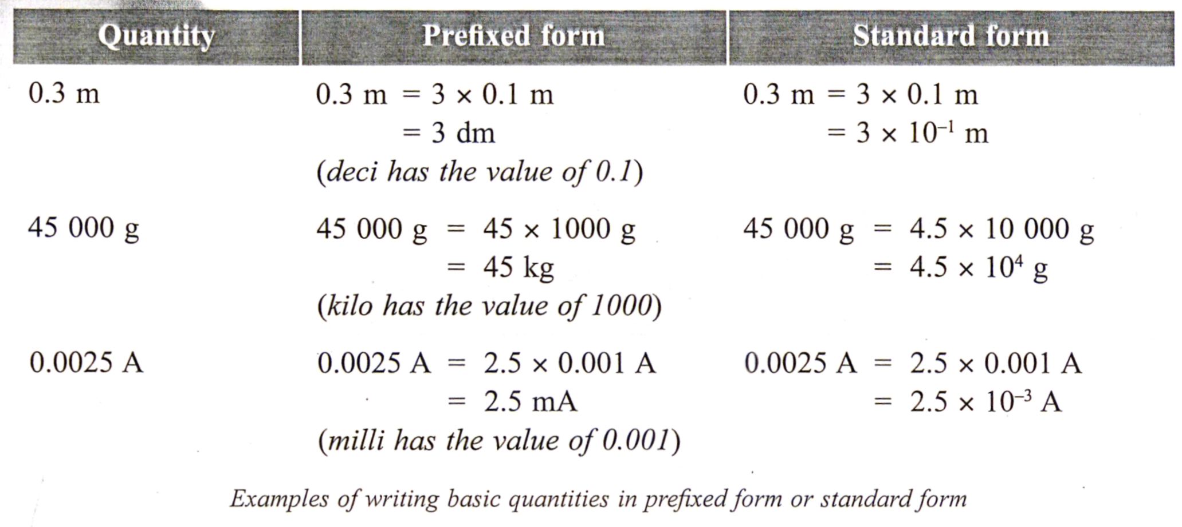
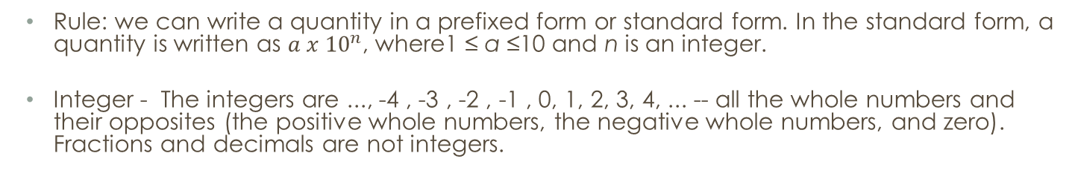
Prefix & standard form
Rule: we can write a quantity in a prefixed form or standard form. In the standard form, a quantity is written as ${a x 10}^{n}$, where1 ≤ a ≤10 and n is an integer.
Integer - The integers are ..., -4 , -3 , -2 , -1 , 0, 1, 2, 3, 4, ... -- all the whole numbers and their opposites (the positive whole numbers, the negative whole numbers, and zero). Fractions and decimals are not integers.

Slide 5
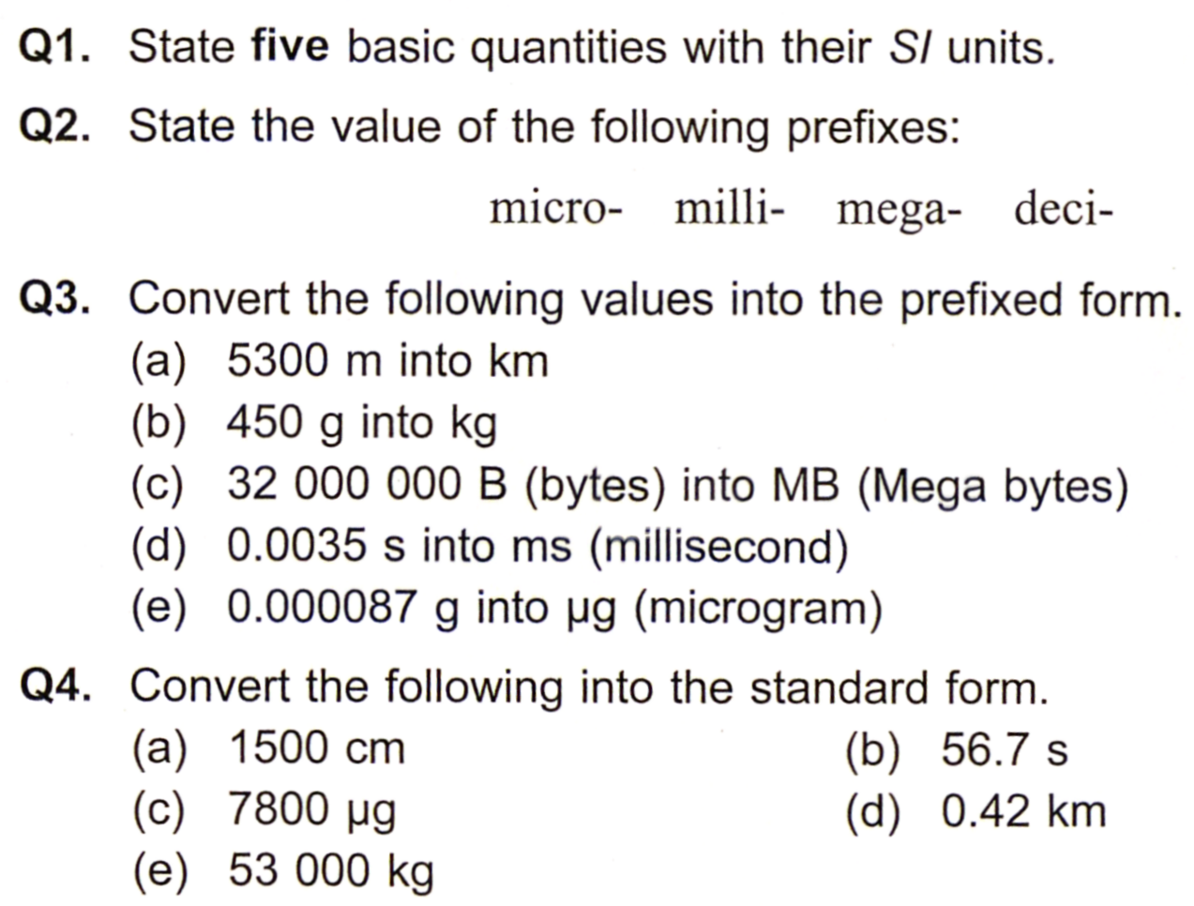
Test yourself

