Slide 1
The Concept of Mass
MASS
It is the amount of matter in substances
Mass and weight are not the same

Slide 2
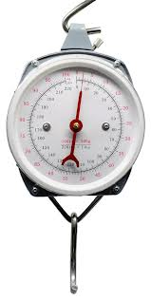
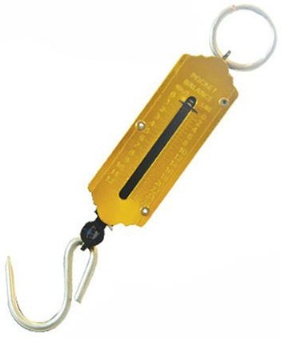
Measuring balance
Lever balance
Spring balance
Beam balance

Slide 3
meaning
SI UNIT – The International System of Units (abbreviated SI from French: Le Système international d'unités) is the modern form of the metric system and is the world's most widely used system of measurement, used in both everyday commerce and science.
Prefix form -A metric prefix or SI prefix is a unit prefix that precedes a basic unit of measure to indicate a decadic multiple or fraction of the unit.

Slide 4
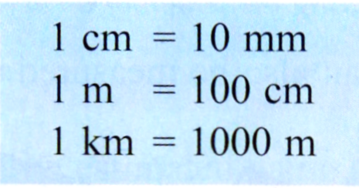
MEASURING TOOLS
Length is the distance between two points. The SI units for length is meter (m).
Short lengths are measured in cm or mm. Long distances are measured in km.

Slide 5
Measuring the length of curved lines
The instruments that can be used to measure the length of a curve are a piece of thread and a ruler.
First, the thread is placed along the curved line. The end of the curve is marked on the thread.
Then, the length of the thread is measured using a ruler.

Slide 6
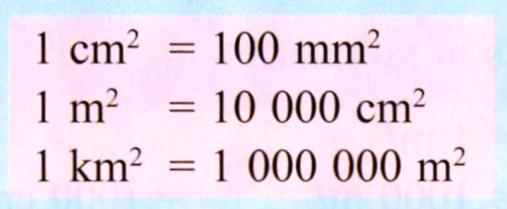
MEASURING AREA
An area is the extent of a surface or a plane figure. The SI unit for area is square meter (m²).

Slide 7
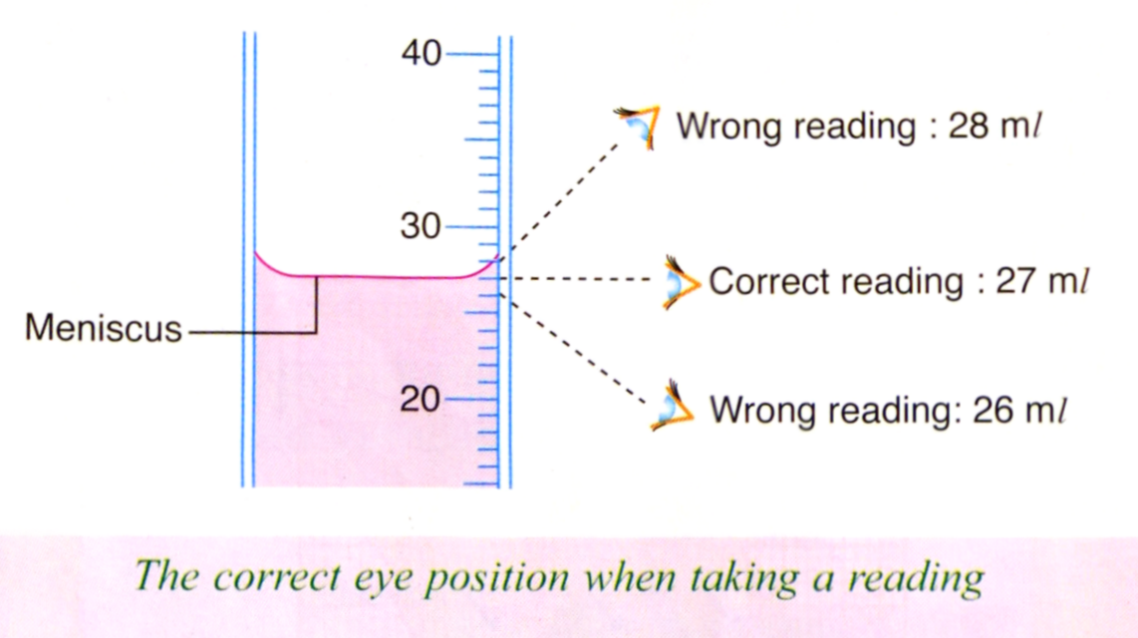
Measuring volume
A volume is the amount of space occupied by a three-dimensional object. The SI unit for volume is cubic meter (m³).

Slide 8
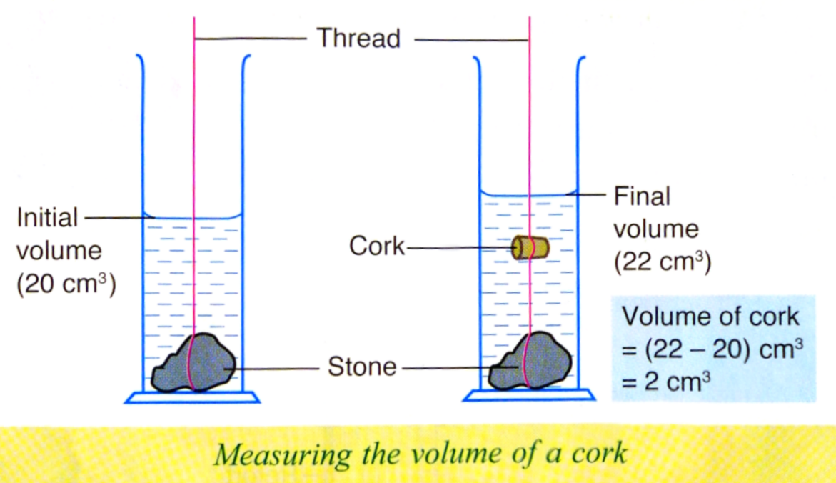
Water displacement method
It is use for measuring the volume of regularly and irregularly shape solids.
For solid less dense than water (like a cork), a weight is tied to it before being immersed in water

Slide 9
Measurement skill

