Slide 1
Natural Resources and the Environment
Unit 2: Lesson 1

Slide 2
Environmental Issues
Write the answers in your notebook:
Why humans are the number one variable on earth?
Address one environmental issue and elaborate.
Share your thoughts about this phrase. “Seven billion dreams. One planet.”

Slide 3
Air pollution
It occurs when the air contains pollutants such as smoke, dirt, dust, and poisonous gases in harmful amounts, endangering living things.
Acid rain, ozone depletion, and global warming are caused by air pollution.

Slide 4
Chlorofluorocarbons or CFCs from coolants in air conditioners and refrigerators, propellants in aerosol cans and solvents in electronic industries are destroying the ozone layer in our atmosphere.

Slide 5
Land Pollution
As population grows, our solid waste materials increase too. Most of these waste materials are not biodegradable.

Slide 6
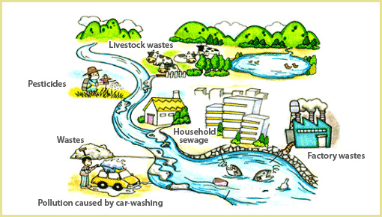
Water Pollution
Discharging industrial, untreated domestic and agricultural wastes as well as untreated sewage into water sources causes water pollution.

Slide 7
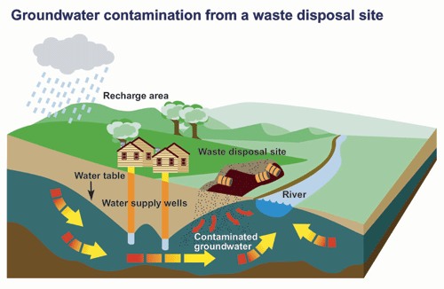
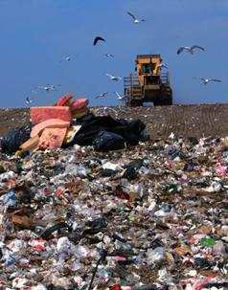
Sanitary Landfills affecting groundwater
Rainwater after filtering down through the landfill may be toxic, depending upon the characteristics of the materials in the landfill. Landfill leachate may mix with the nearby underground water system.

Slide 8
Test Yourself
List three ways how air pollution affects our atmosphere.
What causes ozone depletion?
How can hazardous chemicals from landfills affect groundwater?

Slide 9
Answers

