Slide 1
Atoms, Elements, and Compounds
Unit 2

Slide 2
Atoms
Matter is anything that has mass and takes up space.
Atoms are basic building blocks of all matter.
Subatomic particles: protons (+) electrons (-), and neutrons
1 proton = 1 atomic mass unit (amu)

Slide 3
Atomic Mass Unit
Particle | Charge | Mass (amu)
Proton | +1 | 1.007316
Neutron | 0 | 1.008701
Electron | -1 | 0.000549
What is an Isotope?
Atoms of the same element that differ only in their number of neutrons. Example: Carbon 13 has 7 neutrons.

Slide 4
Test Yourself
Q1: Name the 3 subatomic particles.
Q2: Describe the three subatomic particles.
Q3: Draw a diagram of an atom with its subatomic particles.

Slide 5
Elements
Element is a pure substance that cannot be broken down into other simpler substances by physical or chemical means.

Slide 6
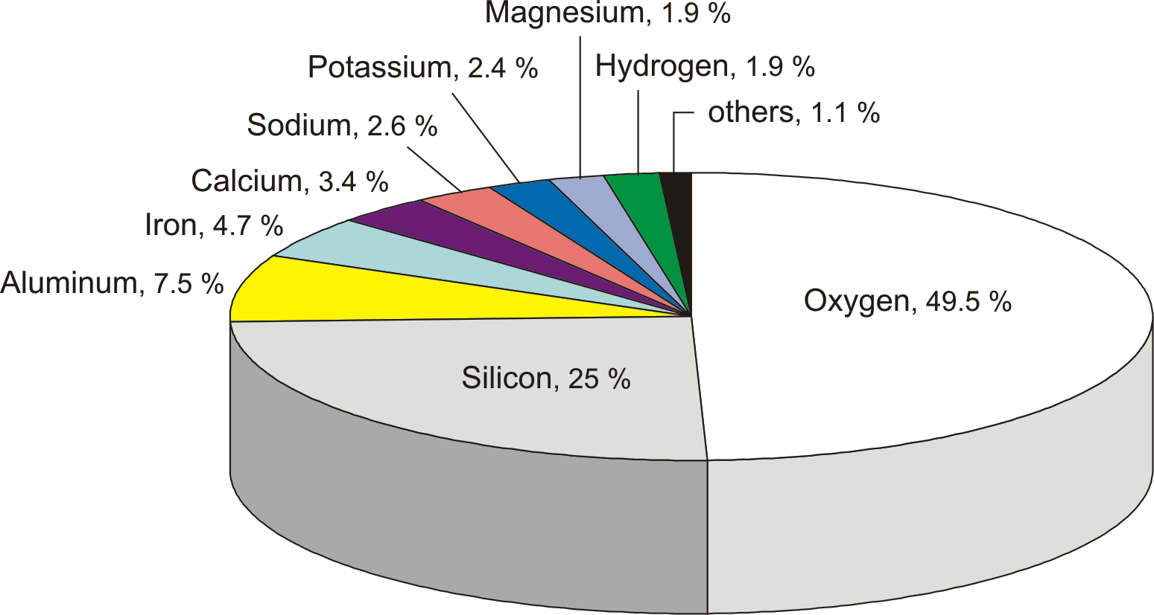
Abundant Elements in the Earth

Slide 7
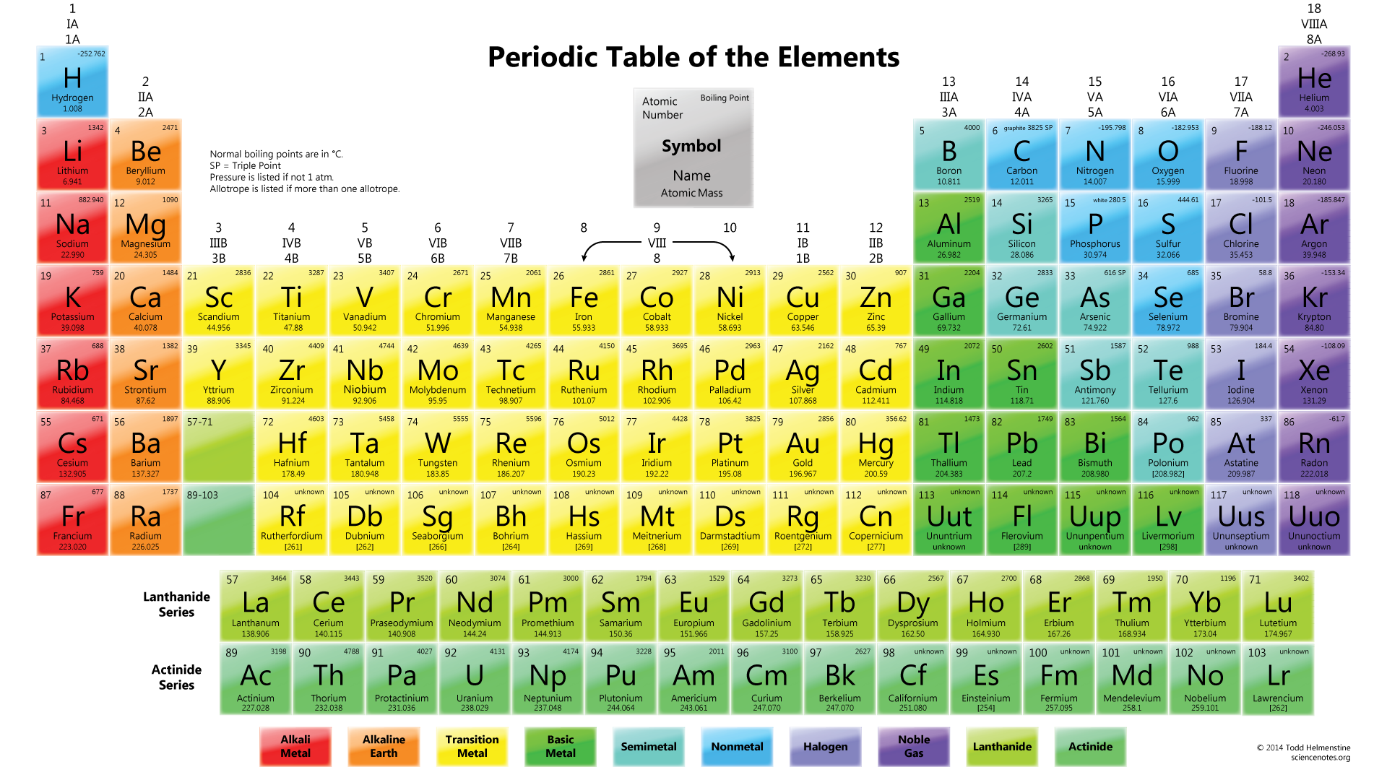

Slide 8
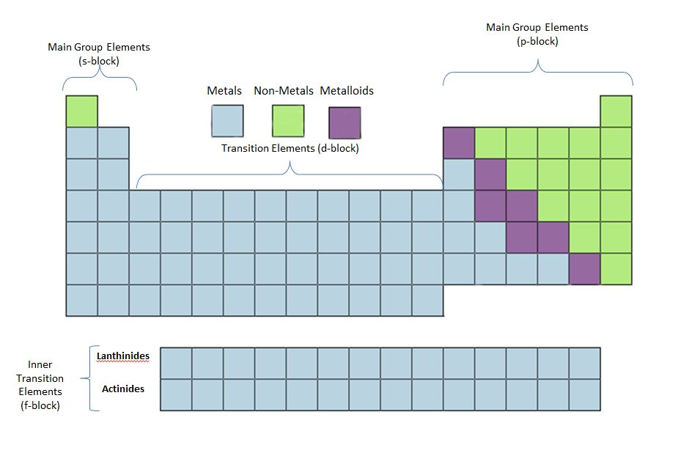

Slide 9
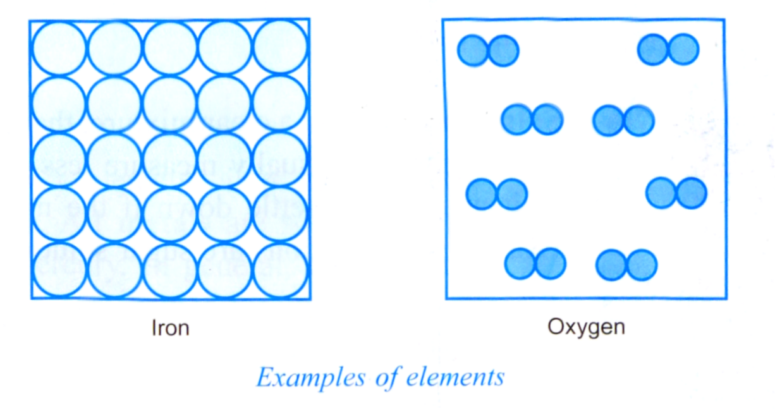
Element consists of only one type of particle.
Different elements are made up of different types of particles.
For examples, iron is made up of iron particle and
oxygen is made up of oxygen particles

Slide 10
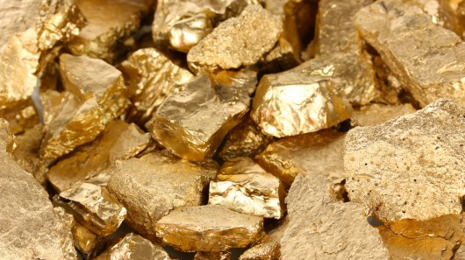
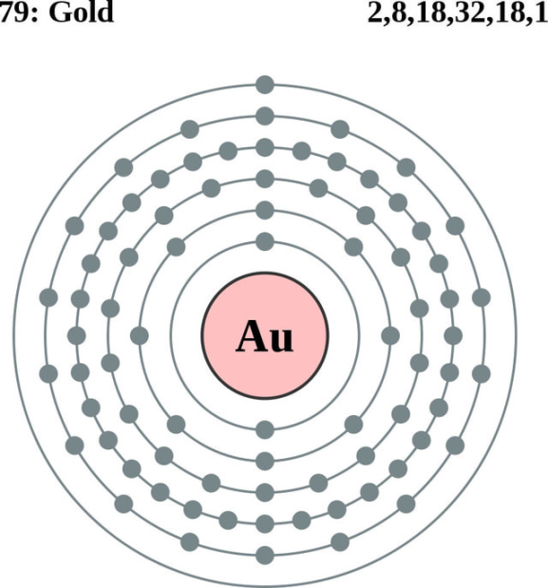
ELEMENT

Slide 11
CLASSIFY ELEMENTS
Metals – solid at room temperature except mercury (ductile, malleable, good conductors, high boiling point & melting points)
Non-metals – mostly gases (low boiling points & melting points, poor conductors)
Metalloids – have both properties of metal and non-metals
VOCABULARY
Ductile – ability to be stretched into a wire.
Malleable –able to be hammered or pressed permanently out of shape without breaking or cracking.
Conductor - an object or type of material that allows the flow of electrical current in one or more directions

Slide 12
Metals, Non-metals, metalloids
All metals are solid at room temperature except mercury. In general, metals have shiny surfaces. Examples are gold, aluminium, copper, iron, lead, silver, platinum, uranium and zinc
Most non-metals are gases. Examples of non-metals are carbon, bromine, sulphur, and iodine. Usually have dull surfaces.
Metalloids are unique as they have some properties of metals and other properties of non-metals at different conditions. Examples of metalloids are silicon, germanium, and arsenic.

Slide 13
metals
PROPERTIES
Shiny surface
Malleable
Ductile
Good Heat Conduction
Good Electricity Conduction
High Melting and boiling point

Slide 14
Ductility is the ability for a material to be pulled into a thin wire.
Malleability is the ability for a material to be flattened into a thin sheet.

Slide 15
Good vs. poor HEAT CONDUCTION

Slide 16
Non-Metals
PROPERTIES
Dull
Not malleable
Poor Heat Conduction
Poor Electricity Conduction
Low melting and boiling point
Brittle

Slide 17
metalloids

