Slide 1
Sun-Earth-Moon
Lesson 5

Slide 2
Gravitational Forces
Gravitational Constant as
6.67 x 10⁻¹¹ Nm²/kg²
6.67 x 10⁻¹¹ m³/kg s²

Slide 3
Example 1
There are two stars. The first star has a mass of 2 x 10¹⁵ kg and the second star has a mass of 4.5 x 10¹⁶ kg. If the stars are 2000 km away, what is the gravitational force felt by the first star?
F= ?
F = G (m1 x m2) /r²
Answer: 1.5 x 10⁹ N

Slide 4
Test Yourself
How come the planets revolve around the Sun?
What does Newton’s law of universal gravitation state?
Two asteroids in space, each has a mass of 200 kg, are 1500 m apart from each other. What is the gravitational force between them?

Slide 5
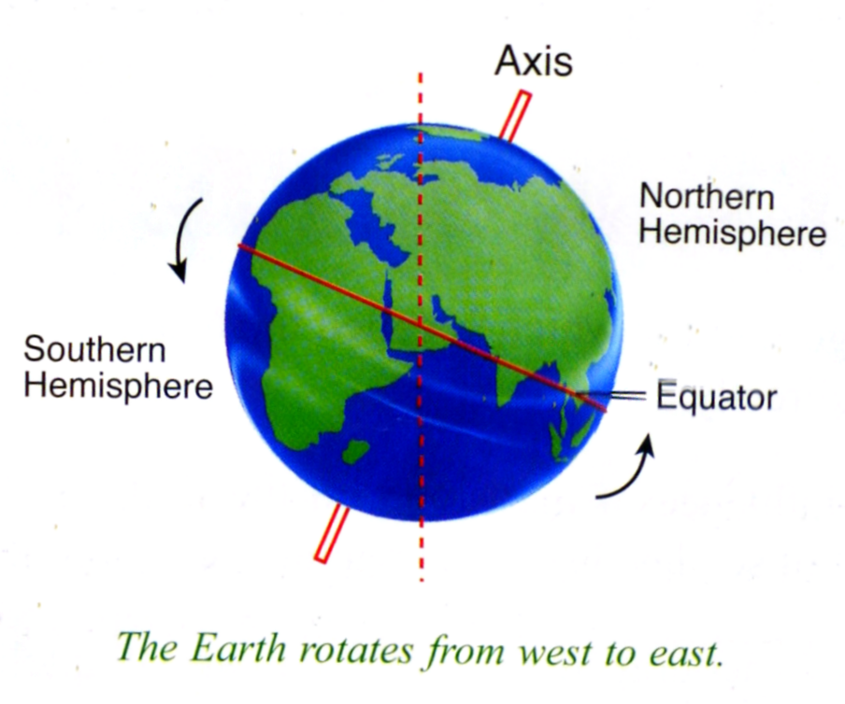
DAY and NIGHT
Our earth is spherical and it rotates on its imaginary axis (23.5 degrees tilt)

Slide 6
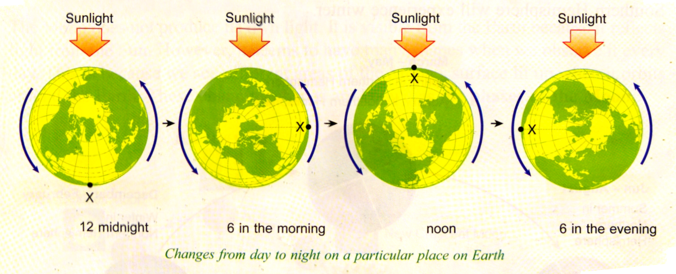
Without the rotation, our earth will be either too hot or too cold for us and each of the side of the planet will be experiencing entire daytime or entire night-time.

Slide 7
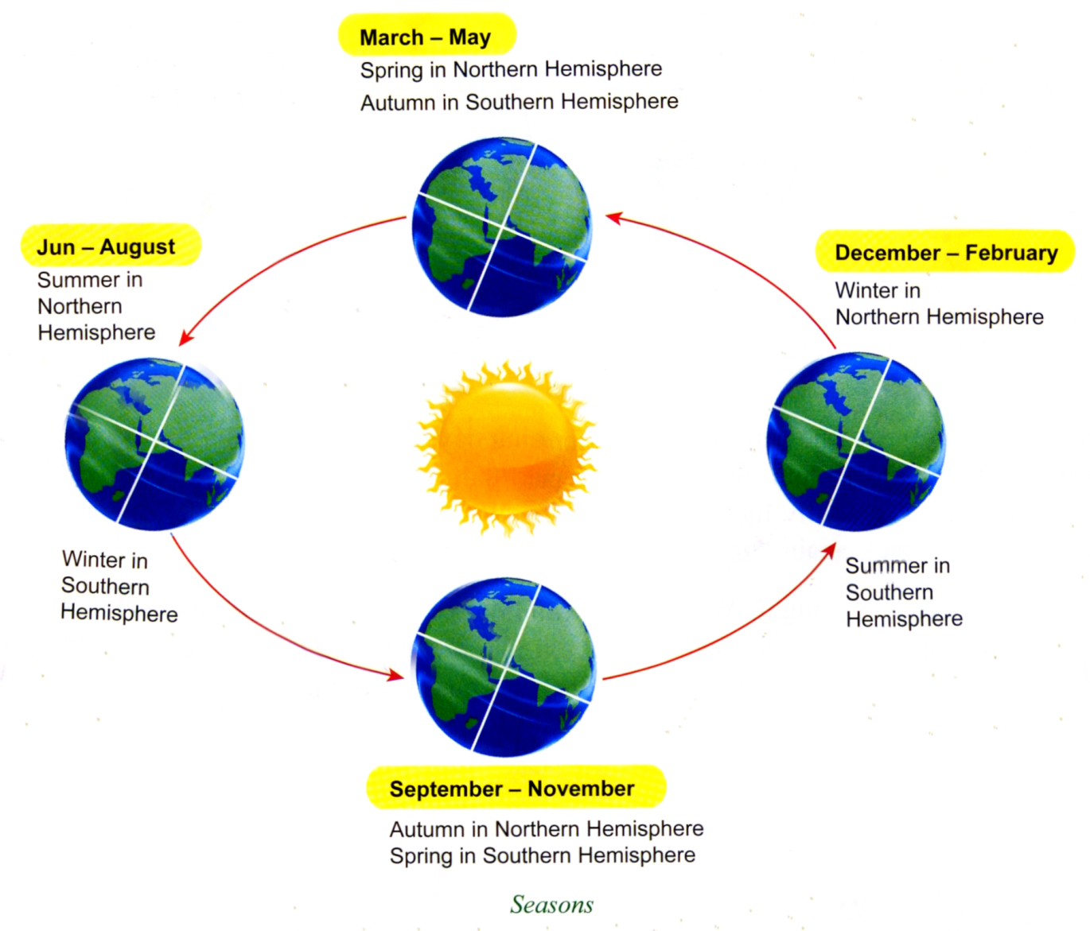
SEASONS
Seasons are caused by the tilt of the earth’s axis and the earth’s movement around the sun.

Slide 8
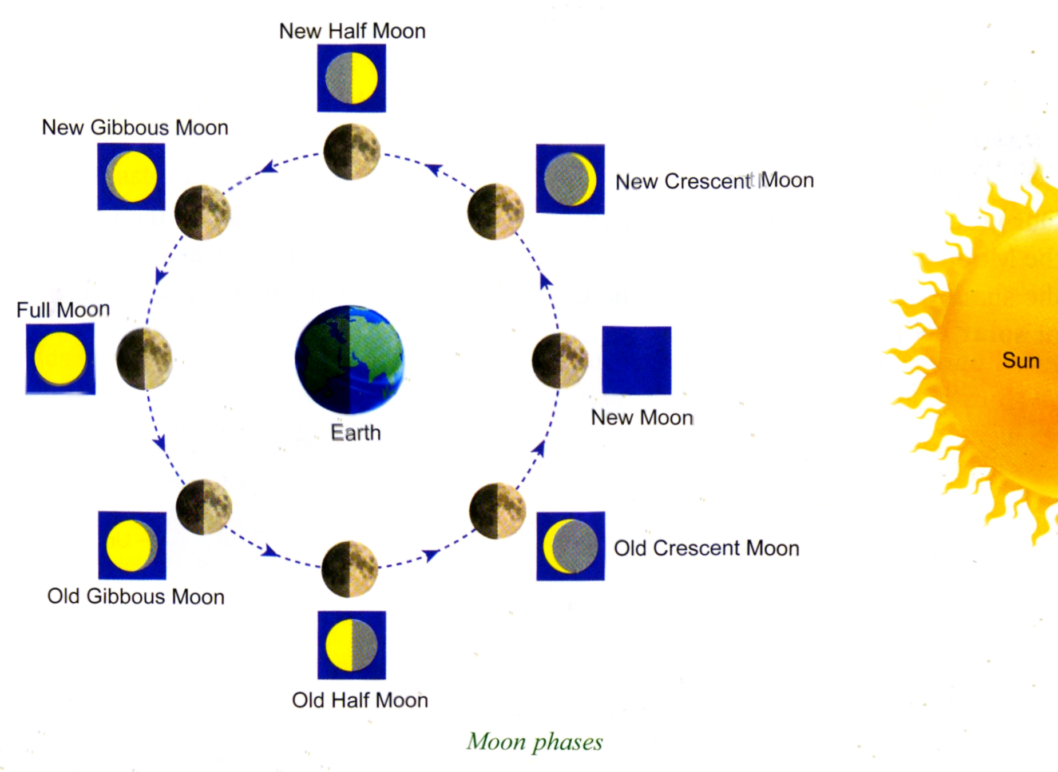
Moon Phases
Moon’s changing shape are known as phases of the moon due to its orbit around the earth.

Slide 9
New Moon | The side of the moon facing the Earth is not illuminated. Additionally, the moon is up through out the day, and down through out the night. For these reasons we can not see the moon during this phase.
Waxing (New) Crescent | During this phase, part of the Moon is beginning to show. This lunar sliver can be seen each evening for a few minutes just after sunset. We say that the Moon is "waxing" because each night a little bit more is visible for a little bit longer.
First Quarter | During first quarter, 1/2 of the moon is visible for the first half of the evening, and then goes down, leaving the sky very dark.
Waxing Gibbous | When most of the Moon is visible we say it is a Gibbous Moon. Observers can see all but a little sliver of the moon. During this phase, the Moon remains in the sky most of the night.
Full Moon | When we can observe the entire face of the moon, we call it a Full Moon. A full moon will rise just as the evening begins, and will set about the time morning is ushered in.
Waning (Old) Gibbous | Like the Waxing Gibbous Moon, during this phase, we can see all but a sliver of the Moon. The difference is that instead of seeing more of the Moon each night, we begin to see less and less of the Moon each night. This is what the word "waning" means.
Last Quarter | During a Last Quarter Moon we can see exactly 1/2 of the Moon's lighted surface.
Waning Crescent | Finally, during a Waning Crescent Moon, observers on Earth can only see a small sliver of the Moon, and only just before morning. Each night less of the Moon is visible for less time.

Slide 10
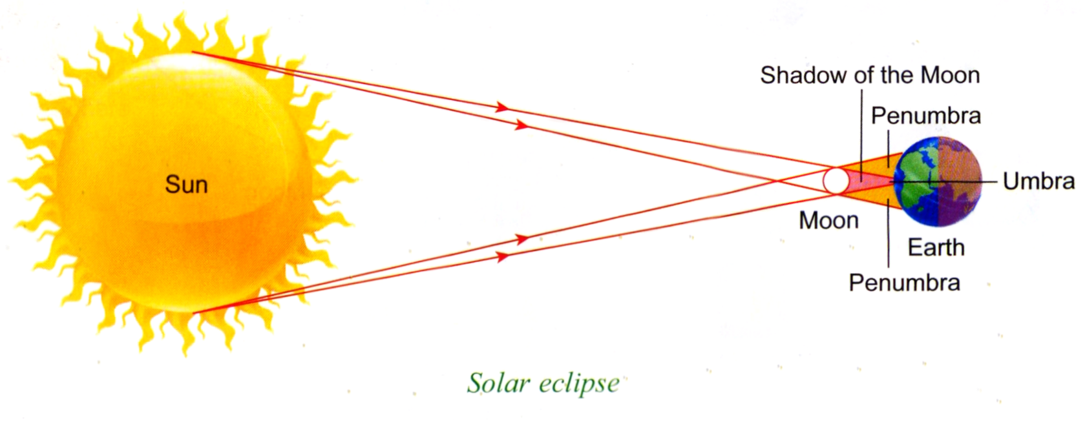
Eclipses
Solar Eclipse - When during new moon phase the shadow of the moon falls on the earth.
Lunar Eclipse - When moon enters a penumbra region, and in the umbra region where we have a total eclipse. The moon turns reddish color and usually last more than an hour.

Slide 11
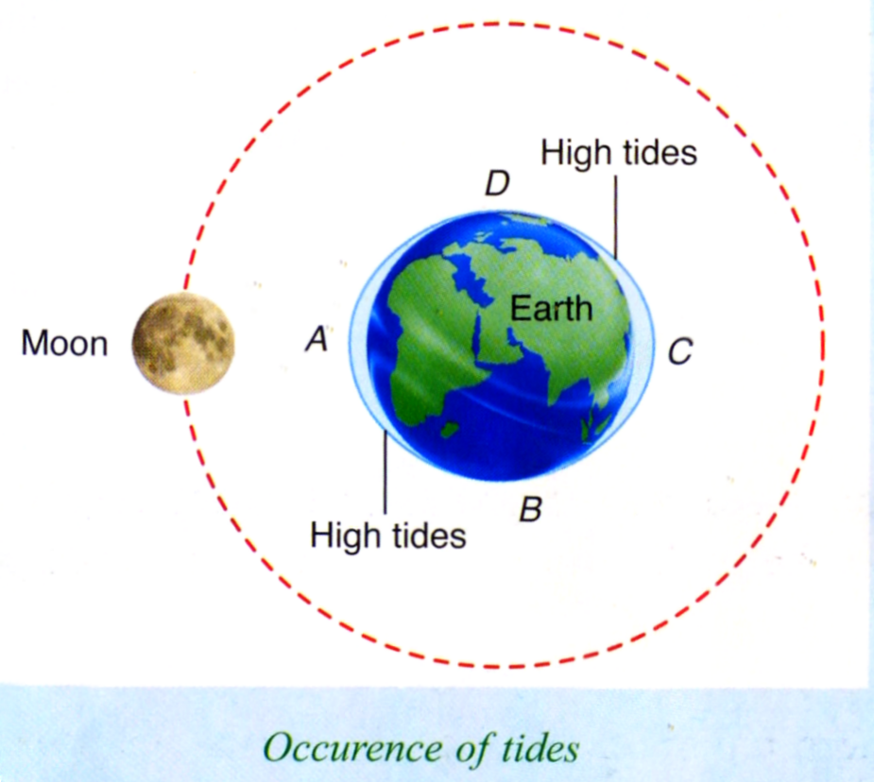
Tides
Are the alternate rising and falling of the ocean in a day. They are caused by the gravitational forces of the moon.
Tides are very important to planet’s life since they create tidal streams that circulate the ocean, bringing fresh food and water to other areas.

Slide 12
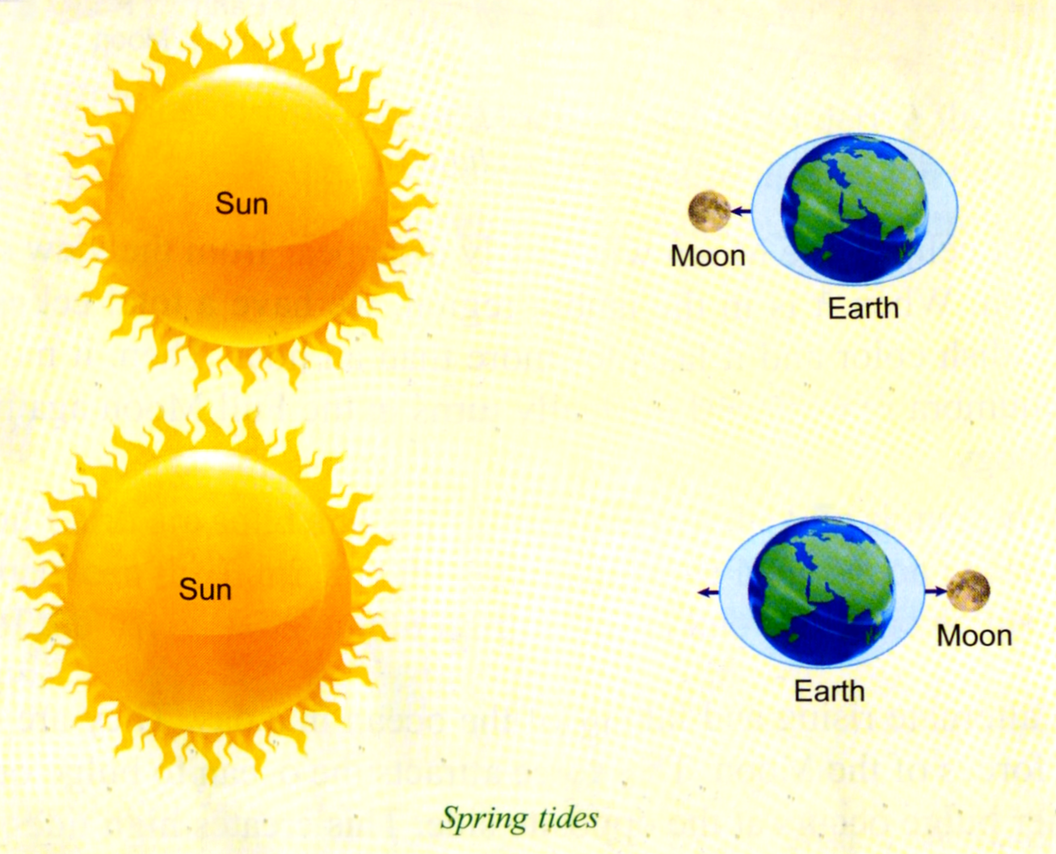
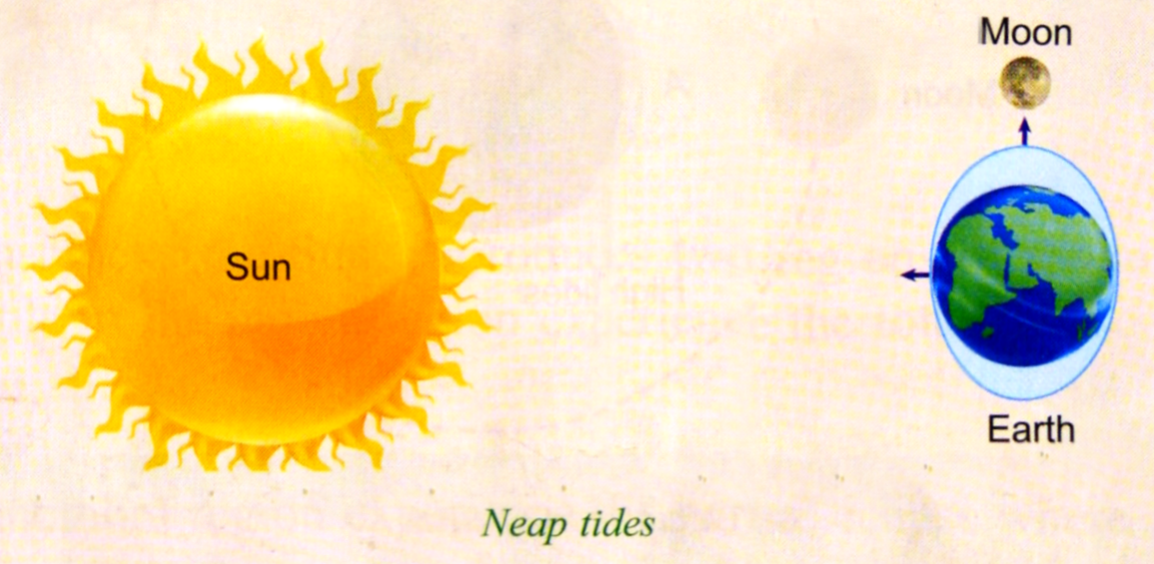
Spring Tides – it happens when it is new moon or full moon, the gravitational forces of moon and sun are combined.
Neap Tides – it happens when it is new half moon or old half moon, the effects of gravitational forces of the sun and moon cancel each other.

Slide 13
Love Yourself
Name five natural phenomena that are due to the positions of the earth, moon, or/and sun.
Give one effect of each of the following statements.
The earth is tilted at an angle of 23.5 degrees.
The earth rotates on its axis.
The moon orbits the earth and reflects light from the sun
Solid objects cast shadows when the sun shines on them.
The gravitational force of the moon and the sun on the earth.

