Slide 1
The Transfer of Genetic Characteristics
Unit 3: Lesson 1

Slide 2
Traits and Heredity Unit
Heredity is the passing down of traits from the parent to offspring.
Genetics is the study of heredity
Gregor Mendel is the father of genetics
Traits a collection of physical characteristics

Slide 3
Genes
Genes are the units of inheritance that determine the characteristics of an individual.
Fertilization is the process where male and female gametes fuse together to form a zygote.

Slide 4
Test Yourself

Slide 5
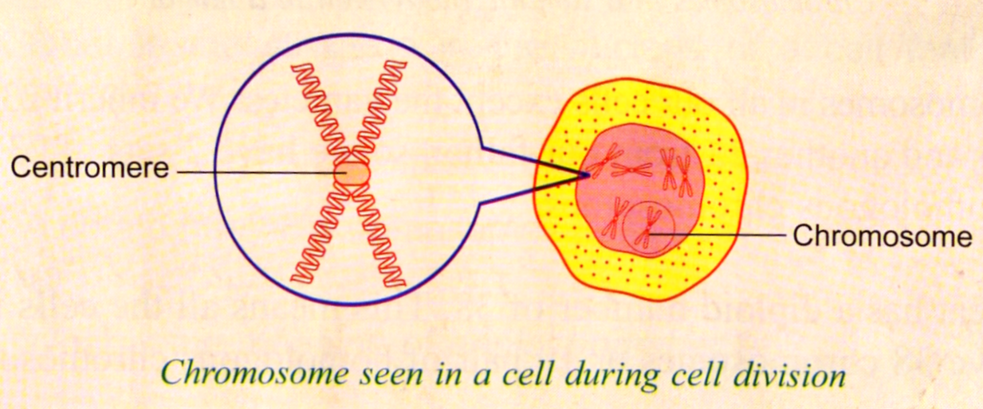
Chromosomes
Chromosomes are thread-like structures in the nucleus that carries the genes.
Chromatin are tangled like a mass of tiny threads

Slide 6
The number of chromosomes in a normal cell is constant for each species of organisms. It is even number and it is called diploid number (2n)

Slide 7
The chromosomes that are similar in size and shape can be paired. A pair of similar chromosomes is called homologous chromosomes.

Slide 8
Gametes contain only half of the diploid number which is called haploid number (n) due to meiosis. During fertilization male and female gametes fused together to form a zygote that has a full diploid number of chromosomes (2n)

Slide 9
Test Yourself

