Slide 1
Thermal Equilibrium and Heat Flow
Lesson 3

Slide 2
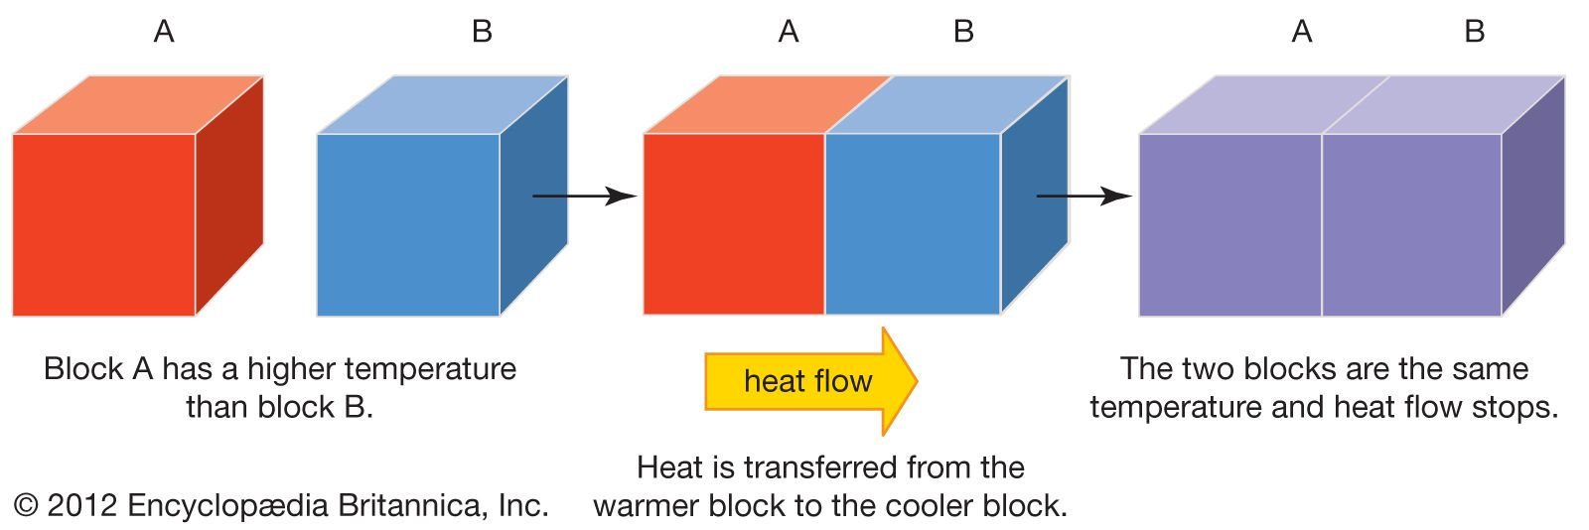
Thermal Equilibrium
Q heat lost = Q heat gained

Slide 3
Example 5
20 g of steel with the temperature of 90°C is dropped into 0.25 kg of water with the temperature of 24 °C. What is the temperature when the steel and water reach thermal equilibrium?
Specific heat capacity of water = 4,200 J/kg °C
Specific heat capacity of steel = 450 J/Kg °C
Solution:
mstell = 0.02 kg cstell – 450 J/kg °C
mwater = 0.25 kg cwater = 4,200 J/kg °C
Solution:
Q lost by steel = Q gain by water
0.02 x 450 x (90 –y ) = 0.25 x 4,200 x (y – 24)
9 x (90-y) = 1050 x (y-24)
810-9y = 1050 y – 25,200
25,200 + 810 = 1050 y + 9y
26,010 = 1059 y
y = 26,010/1059
y = 24.56 °C

Slide 4
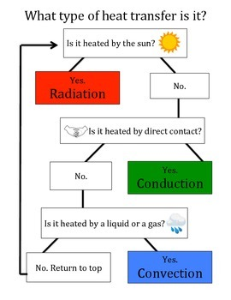
Heat Flow

Slide 5
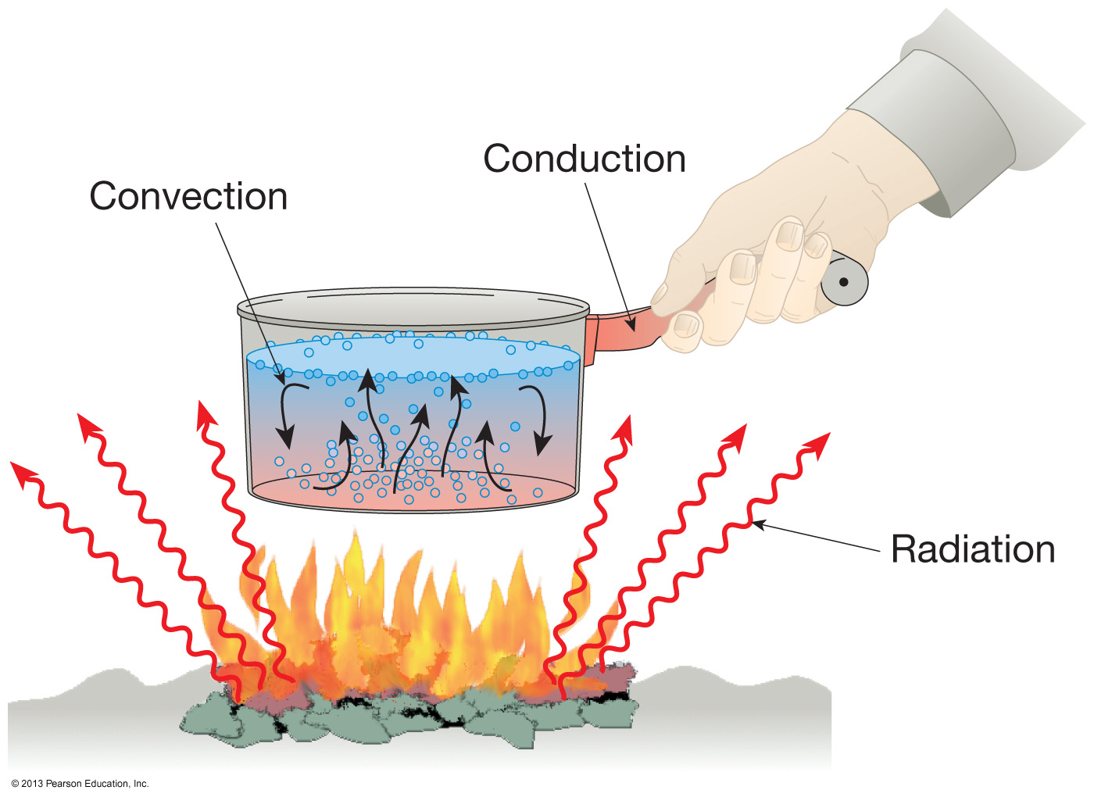
Benefits of Heat Flow

Slide 6
Test Yourself
Answer Textbook page 152

