Slide 1
Thunderstorms and Tropical Cyclones
Atmosphere and Weather

Slide 2
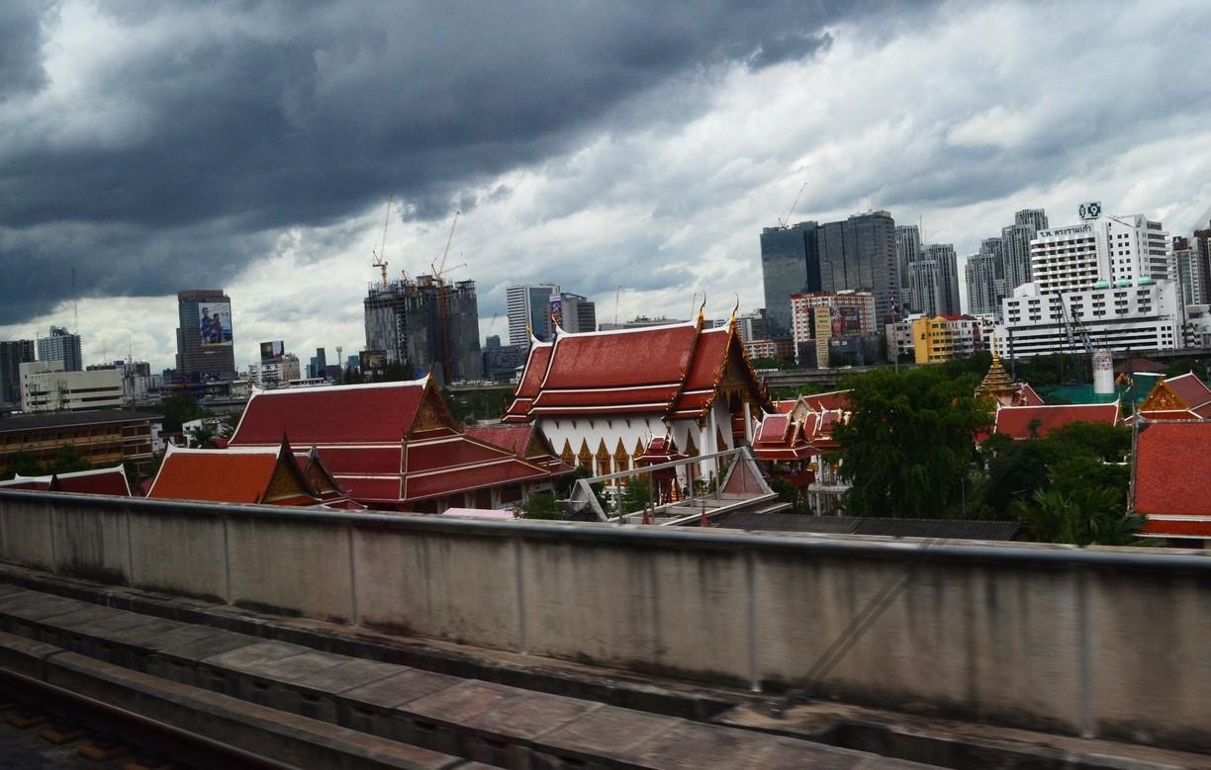
T-Storm
A form of weather characterized by the presence of lightning and its attendant thunder.
Formation: Sun heats up the earth’s surface, surface heats up the air above it, warm moist air rises forming a cumulus cloud, cloud continues to grow, as warm air continues to rise, warm air meets very cold air, when these air collide, lightning and thunder will take place. Later the cloud becomes very large and heavy, then rain starts to fall. About 30 minutes thunderstorm begins to dissipate.
Thailand during Southwest Monsoon

Slide 3
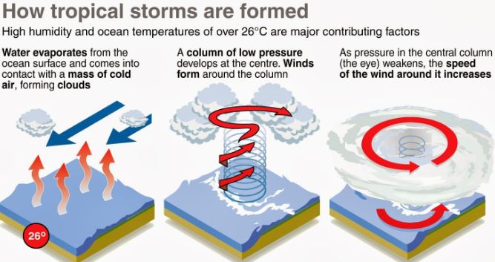
Tropical Cyclone
A circular storm that brings heavy rain and strong winds in tropical areas. It usually forms over warm oceans and often moves onto the land.
Formation:
The sea temperature is above 26 degree Celsius.
The humidity is high.
It happens near the equator.

Slide 4
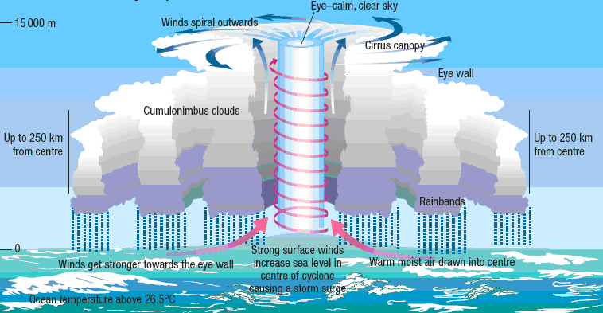

Slide 5
Test Yourself
Differentiate between a thunderstorm and a tropical cyclone.
What are the effects of thunderstorm?
What should you do when the meteorological department issues a tropical cyclone warning for your area?

