Slide 1
Unicellular and Multicellular Organisms
LESSON 3

Slide 2
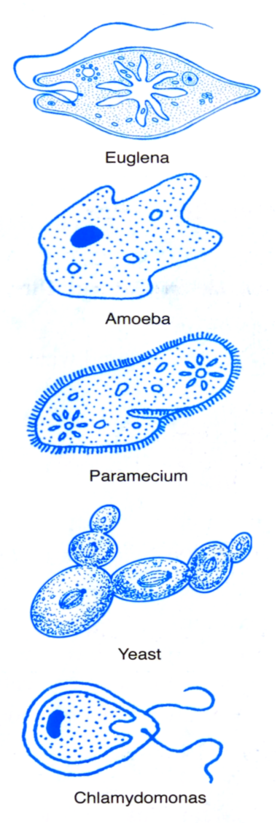
Unicellular Organisms
Organisms that consist of one cell.
They are also known as microorganisms
They also carry out all the life processes such as movement, response, respiration, digestion, excretion, reproduction, and growth

Slide 3
Multicellular Organisms
Organisms that consists of many cells that are usually complex.
Hydra, earthworm, deer, spirogyra, mucor, grass

Slide 4
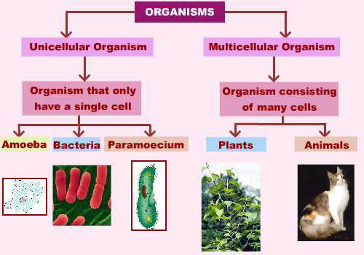
UNICELLULAR VS. MULTICELLULAR

Slide 5
Unicellular and Multicellular Organisms
Unicellular | Multicellular
Euglena (protist) | Hydra (fresh water animal)
Amoeba (protist) | Earthworm
Paramecium (protozoa) | Deer
Chlamydomonas (algae) | Spirogyra (algae)
Most bacteria | Mucor (fungus found in rotten vegetables)
Yeast (fungus) | Plants and Animals

Slide 6
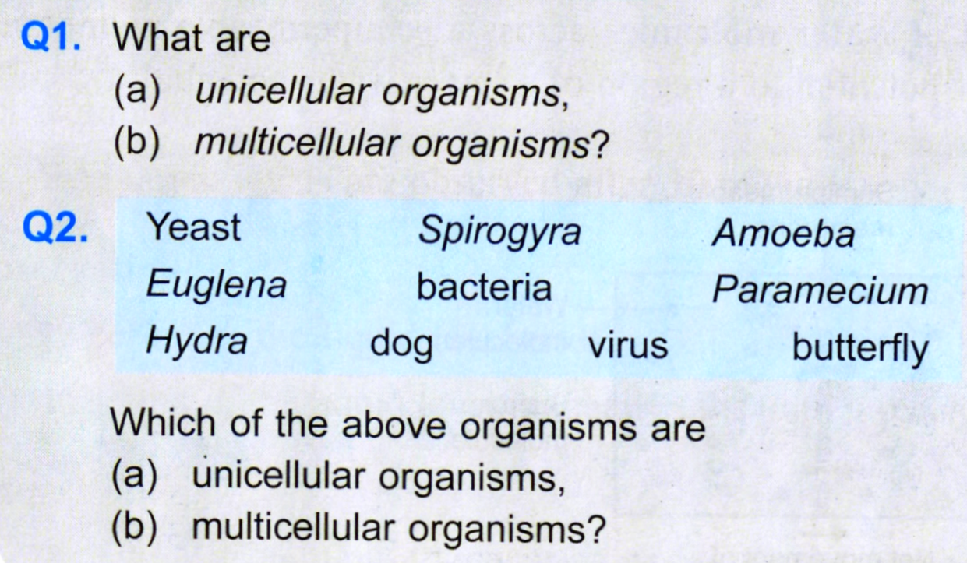
Test Yourself

