Slide 1
waves
Transverse & Longitudinal

Slide 2
What are waves?
Wave is a travelling disturbance from a vibrating or oscillating source.
As it travels, it carries energy along with it in the direction of its propagation.

Slide 3
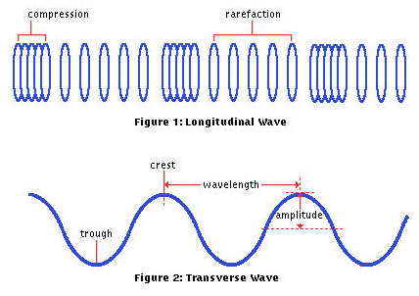
All waves can be group into two types:
Transverse wave has vibrations in a direction perpendicular to the direction of the wave.
Longitudinal wave has vibrations in a direction parallel to the direction of the wave.

Slide 4
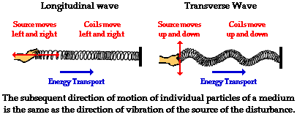
Transverse and Longitudinal Waves

Slide 5
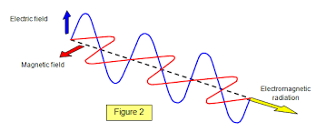
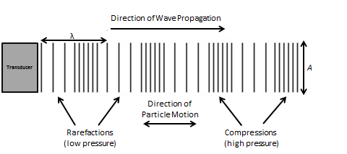
Transverse | Longitudinal
1. Consist of crests and troughs | Consist of compressions and rarefactions
2. No pressure variations | Pressure variations throughout the medium
3. Particles of the medium vibrate at right angles to the direction of wave propagation. | Particles of the medium vibrate parallel to the direction of the wave propagation.
Ex. Light wave | Sound wave

Slide 6
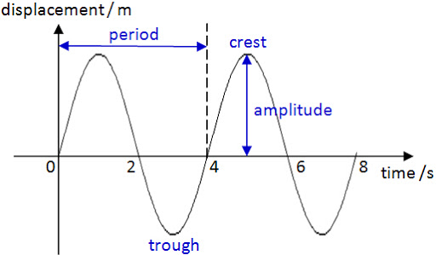
Transverse Wave
Crests and Troughs are the highest and lowest points for a transverse wave.
Amplitude or a, is the maximum displacement of the point from its resting position.
Wavelength or λ, is the distance between two successive equivalent points on the wave.
Frequency or f, is the number of complete waves produced per second.
Period or T, is the time taken to produce a complete wave.
f = 1/T

