Slide 1
WEATHER
Unit 1b

Slide 2
QUESTIONS
Describe the difference between weather, season, and climate.
In what particular layer of the atmosphere the weather will take place?
How’s the weather today?

Slide 3
WEATHER
It refers to the present state of the atmosphere.
Description of weather includes type of cloud, measurements of temperature, wind speed and direction, rain, snow, thunderstorms, and humidity.

Slide 4
It could be sunny or cloudy, windy or still, wet or dry…

Slide 5
METEOROLOGY
The study of the entire atmosphere, including the weather.
Meteorologist is a scientist who studies the causes of the weather conditions and also forecasts the weather.

Slide 6
WEATHER FORECAST
It is a prediction about the weather that will be experienced a short time in the future.
This station record information about weather. They have instruments to measure temperature, snow/rainfall, wind speed and direction, air pressure, and humidity

Slide 7
Weather Stations

Slide 8
WEATHER FACTORS
Weather describes the current conditions such as;
Air Pressure
Humidity (Air Density)
Temperature
These factors have great effect on the formation of cloud, rain, and wind.

Slide 9
Weather Components
Air temperature
Atmospheric Pressure
Humidity
Speed of Wind
Direction of the Wind
Cloudiness
Precipitation
Altitude

Slide 10
Air Temperature
The air temperature varies at different time of the day, seasons of the year, and from place to place too.
Tool: Thermometer

Slide 11
Atmospheric Pressure
It is the amount of force exerted by the weight of the air in the atmosphere on the Earth’s surface.
A higher air pressure indicates sunny and dry conditions, while a lower air pressure indicates approaching stormy or bad weather.
Tool: Barometer

Slide 12
Humidity
It is the amount of water vapor in the atmosphere affected by air temperature.
When relative humidity is high, the air is saturated with water vapor and the sweat from our bodies does not evaporate. As a result, we feel warm and sticky!
Tool: Psychrometer

Slide 13
Speed of Wind
Wind is moving air. The sun heats our Earth unevenly. Some places are heated up more than others.
Tool: Anemometer

Slide 14
Direction of Wind
The earth is rotating, has mountains, and other kinds of barriers.
Tools: Wind Vane

Slide 15
Cloudiness
The higher the clouds the better the weather will be.
Higher clouds indicate both dryness of air and higher atmospheric pressure. Both these qualities are present with fair weather.
Cirrus Clouds: It usually indicate fair to pleasant weather.

Slide 16
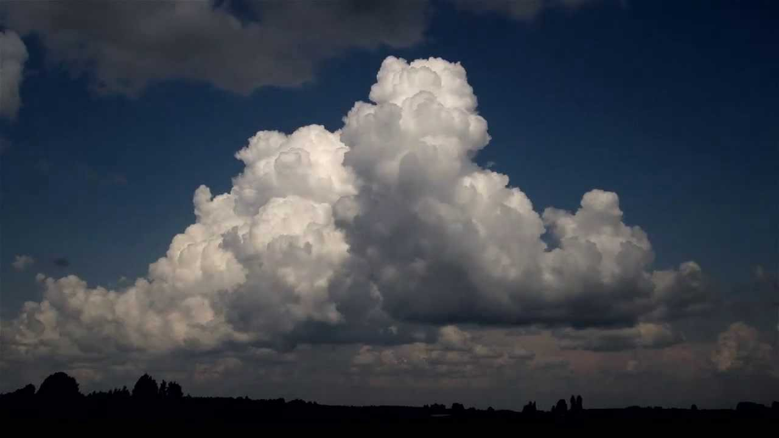
Cumulus Clouds
Cumulonimbus Clouds
Usually indicate fair weather
Usually produce heavy rain, lightning, and thunder

Slide 17
Precipitation
Is any moisture that falls from the air to the ground.
Tool: Rain gauge

Slide 18
Altitude
Altitude is how one is above sea level.
Air temperature decreases as altitude increases.
Air pressure and density are lower at high altitude.

Slide 19
TEST YOURSELF
What is weather?
List 5 benefits of having weather forecasting.
List the components of weather and the instruments to measure them.
How do the temperature and atmospheric pressure change with the altitude?

Slide 20
AIR PRESSURE
Also known as atmospheric pressure
It is the weight of the air pushing down and the collisions between molecules
Measured in barometers
Changes in air pressure bring changes in the weather and make wind blow.
Air usually moves from areas of high pressure to areas of low pressure and this produces wind.

Slide 21
HUMIDITY
The amount of water vapor in the air.
Relative Humidity – is the amount of water vapor that is currently in the air compared to how much the air can hold at a specific temperature.
Measured in hygrometers
At cooler temperature, the molecules in the air move slower. This slow movement allows the water vapor to join together and condense.
At warmer temperature, the molecules move too fast to join together. Therefore, cooler air holds less water vapor and has lower humidity.

Slide 22
TWO TYPES OF HUMIDITY
ABSOLUTE HUMIDITY
Is the exact measurement of how much water vapor is in the air.
It’s very similar to density.
RELATIVE HUMIDITY
It is the comparison of amount of water vapor in air to the maximum amount (saturation/dew point)
The one used in weather report
Measured and calculated
Relative humidity is expressed as a %.

Slide 23
TEMPERATURE
Temperature is a measure of the average kinetic energy of the particles in a sample of matter.
The amount of water vapor that the air can hold depends on the temperature.
Cooler air hold less water vapor and has lower humidity.
As the air is heated up, it expands but the collisions of molecules become faster. Therefore, air pressure would be greater. Also, in an environment where water is much available, humidity goes high when it’s warmer, consequently, adds pressure during sunny day because the denser the air the more collisions will take place between molecules.

Slide 24
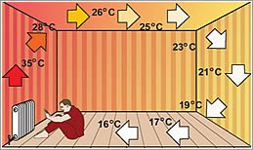
CONVECTION

Slide 25
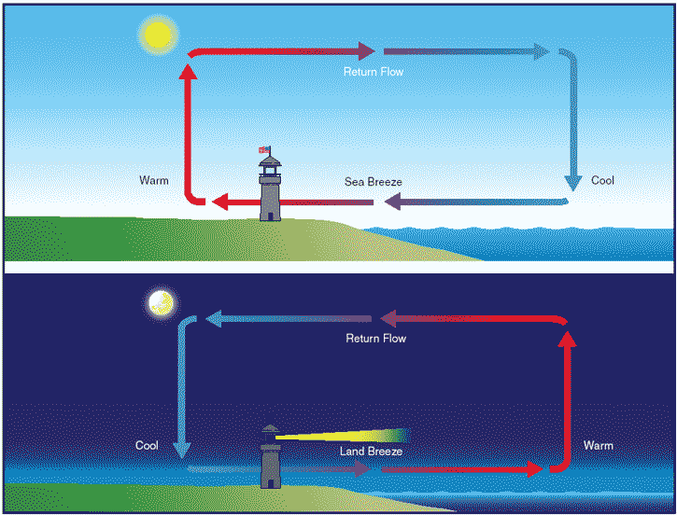

Slide 26
Questions
What is weather?
Describe the difference between weather and climate.
What is convection?
How does the air move in relation to atmospheric pressure?

Slide 27
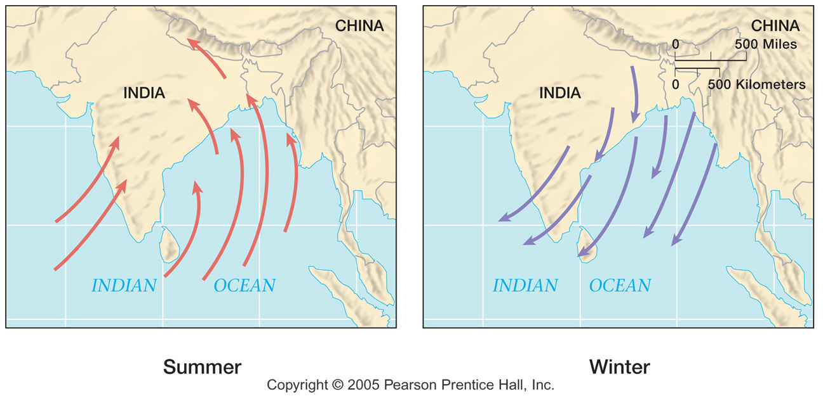
Monsoon
Monsoon – are called seasonal winds. Are caused by the fact that land heats up and cools down quicker than water.

Slide 28
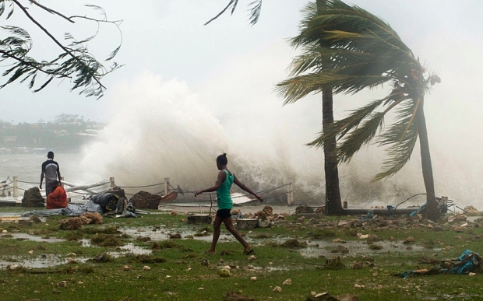
Tropical Cyclone
Tropical Cyclone – is a type of low pressure system which generally forms in the tropics. It is a large, rotating area of clouds, with wind and thunderstorm activity.

Slide 29
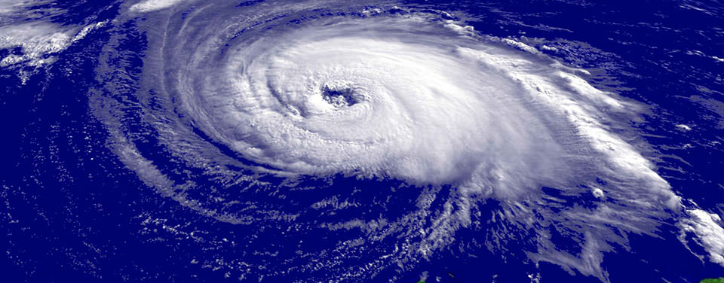
Difference Between Hurricanes, cyclones, and typhoons
Hurricanes, cyclones, and typhoons are all the same weather phenomenon; we just use different names for these storms in different places. In the Atlantic and Northeast Pacific, the term “hurricane” is used. The same type of disturbance in the Northwest Pacific is called a “typhoon” and “cyclones” occur in the South Pacific and Indian Ocean.

Slide 30
Questions
If the weather is sunny, what would be the barometric pressure? Low or high (rising or falling)?
What is the condition of air pressure when there’s a thunderstorm?

